Slide 1
DRIVER WALA
Krunal Dilipbhai Ninama [Roll No:IT21022]
SHRI A.N PATEL INSTITUTE OF SCIENCE AND RESEARCH,ANAND

Slide 2
INTRODUCTION
Driver wala Project using python and PostgreSQL is a web application technology that will manage the records of the driver and users.
It’s easy for Admin to retrieve that data of drivers and users Driver wala Project in python is an automatic system that delivers data processing at very high speed in a systematic manner this application provide convenient and best services to customers (who wants to hire a driver )and driver (which want to register)who easily register himself/herself.

Slide 3
PURPOSE
The Purpose of the system is to provide a platform for NRI’s, local people/senior citizens, and other individuals to easily book drivers for travelling purposes within and outside of traveling purposes.
The system will also provide employment opportunities for drivers .

Slide 4
MODULE OF SYSTEM
1.Driver management
2.User management
3.Admin management
4.Payment management
5.Booking management

Slide 5
TOOLS & TECHNOLOGY
Tools and Technologies | Frameworks
Technology | Python
Database | postgreSQL
Framework of python | Django
CSS Framework | Bootstrap

Slide 6
USER IN SYSTEM
1.Admin
2.Driver
3.customer

Slide 7
ADMIN
1.Login
Admin Will Login with the help of username and password if the username and password is correct then it will redirect to admin panel otherwise wrong username or password.
2.Manage Account
Admin can add, update, delete information.
3.Offers
Admin can add, update, delete offers.

Slide 8
ADMIN
4.Payment
Admin can view the payment details

Slide 9
DRIVER
1.Registration
Driver can fill his personal details in registration form like Name, contact no, licence image, adhar image, email-id etc...
2.Login
Driver can Login help of password and user name
3.Manage account
Driver can manage his account like change password Update Details etc..

Slide 10
CUSTOMER
1.Registration
Customer can fill his information in registration form like name, contact no, password etc...
2. Login
Customer can login help of password after login he view his booking details
3.Offers
Customer can view offers

Slide 11
LIMITATIONS

Slide 12
Customer
4.Manage account
Customer can also manage his account like change password, update his details etc..

Slide 13
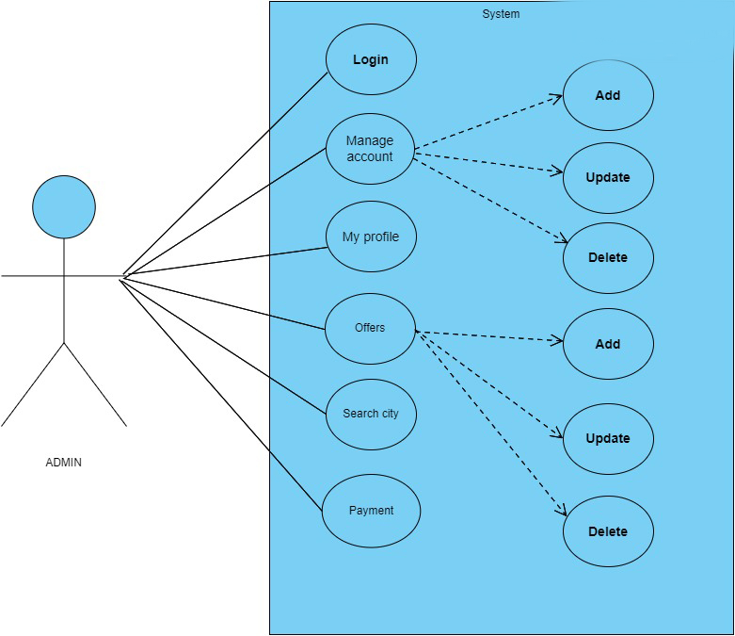
USECASE DIAGRAM[ADMIN]

Slide 14
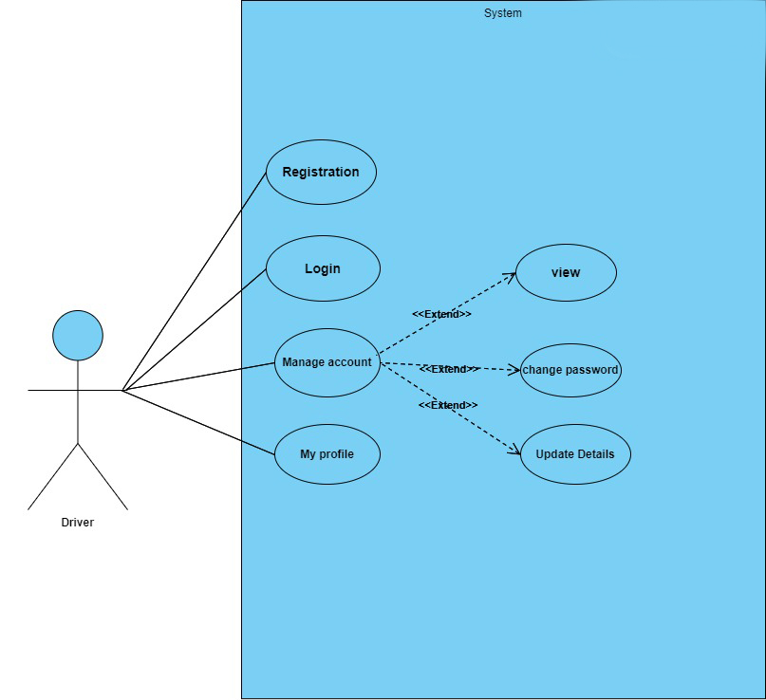
USECASE DIAGRAM[DRIVER]

Slide 15
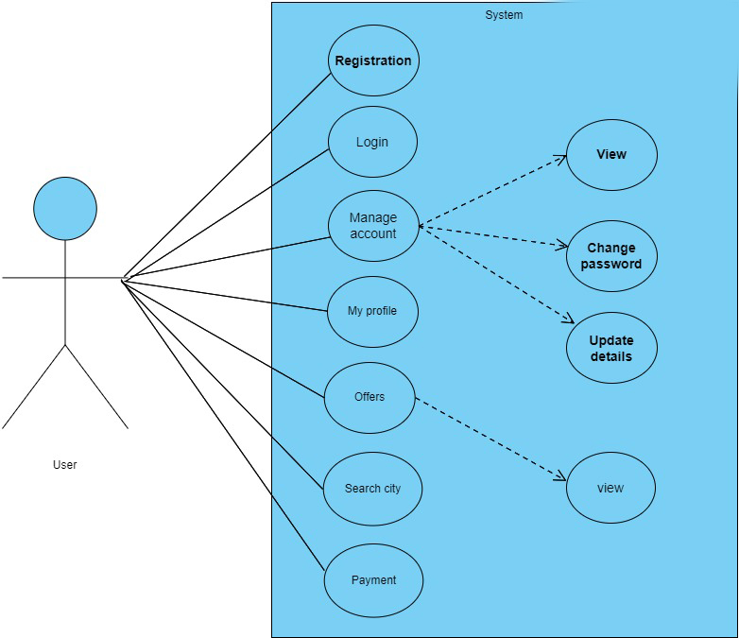
USECASE DIAGRAM[USER]

Slide 16
DATABASE TABLES
1)DRIVER REGISTRATION
Name | Data Type | Size | Not NULL | Description
Id | Bigint | 10 | NO | Primary Key(Auto increment)
Fname | Character | 50 | NO | To store first name of driver
Mname | Character | 50 | NO | To store middel name of driver
Lname | Character | 50 | NO | To store last name of driver
Phone | Integer | 12 | NO | To store phone number of driver
Email | Character | 50 | NO | To store email of driver
Address | Text | 100 | NO | To store address of driver
City | Character | 20 | NULL | To store city of driver

Slide 17
DRIVER REGISTRATION
Name | Data Type | Size | Not NULL | Description
Zipcode | Integer | 10 | NULL | To store zipcode of driver
State | Character | 10 | NULL | To store state of driver
Aadharno | Bigint | 12 | NULL | To store adharno of driver
Vtype | Character | 10 | NULL | To store vehicle type
Vname | Character | 10 | NULL | To store vehicale name
Driving_licence | Character | 100 | NULL | To store driving licence
Selfie | Character | 100 | NULL | To store selfie of driver
Password | Character | 10 | NULL | To store password of driver
Is_active | Boolean |  |  | Admin to boolean check driver is active or inactive
2)

Slide 18
2)CUSTOMER REGISTRATION
Name | Data Type | Size | Not NULL | Description
Id | bigint | 10 | NO | Primary key(Auto increment)
Name | Character | 50 | NO | To store customer name
Email | Character | 50 | NO | To store customer email
Mobile number | Character | 12 | NO | To store customer mobile no
Address | Text | 100 | NO | To store customer address
Is_active | Boolean |  |  | Boolean to admin check user is active or inactive
Selfie | Character | 100 |  | To store customer selfie
Password | Character | 20 | NO | To store customer password

Slide 19
Main state
3)
Name | Data Type | Size | Not NULL | Description
id | Bigint | 10 | NULL | Primary Key
Name | Character | 50 | NULL

Slide 20
ADMIN
Name | Data Type | Size | Not NULL | Description
Id | Integer | 10 | NULL | Primary Key(Auto increment)
Password | Character | 20 | NULL | To store password
Username | Character | 10 | NULL | To store username
First_name | Character | 20 | NULL | To store first name
Last_name | Character | 20 | NULL | To store last name
Email | Character | 50 | NULL | To store email
Is_active | Boolean |  | NULL | Admin to boolean check is active or inactive
Date_joined | Timestamp |  | NULL | To check joining date
4)

Slide 21
BLOGPOST
5)
Name | Data Type | Size | Not NULL | Description
Id | Bigint | 10 | NULL | Primary Key(Auto increment)
Title | Character | 50 | NULL | To store title of post
Content | Text | 100 | NULL | To store content of post
Date_posted | Timestamp |  | NULL | To store date of post

Slide 22
MAIN PLAN
6)
Name | Data Type | Size | Not NULL | Description
Id | Bigint | 10 | NULL | Primary Key(Auto increment)
Name | Character | 50 | NULL | To store name of plan
Price | Numeric | 8 | NULL | To store price
Months | Integer |  | NULL | To store months

Slide 23
DRIVER TYPE
Name | Data Type | Size | Not NULL | Description
Id | Bigint | 10 | NULL | Primary Key(Auto increment)
Name | Character | 50 | NULL | To store name
Image | Character | 100 | NULL | To store image
8)

Slide 24
DISTRICT
Name | Data Type | Size | Not NULL | Description
id | Bigint | 10 | NULL | Primary Key(Auto increment)
Name | Character | 50 | NULL | To store district name
State_id | Bigint |  | NULL | To store state id
9)

Slide 25
CONTACTUS
10)
Name | Data Type | Size | Not NULL | Description
id | Bigint | 10 | NULL | Primary Key(Auto Increment)
Name | Character | 50 | NULL | To store name
Ermail | Character | 50 | NULL | To store email
Subject | Character | 200 | NULL
Comments | Text | 200 | NULL | To store comments

Slide 26
SUBDISTRICT
11)
Name | Data Type | Size | Not NULL | Description
Id | Bigint | 10 | NULL | Primary Key(Auto Increment)
Name | Character | 50 | NULL | To store name of sub district name
District_id | Bigint | 10 | NULL | To store district id

Slide 27
PAYMENT DETAILS
7)
Name | Data Type | Size | Not NULL | Description
Id | Bigint | 10 | NULL | Primary Key(Auto Increment)
Payment_for | Character | 10 | NULL | To store payment details
Amount | Numeric | 8 | NULL | To store amount
Transaction_id | Character | 10 | NULL | To store transaction id
Driver_id | Bigint | 10 | NO | To store driver id
Status | Character | 20 | NULL | To store status

Slide 28
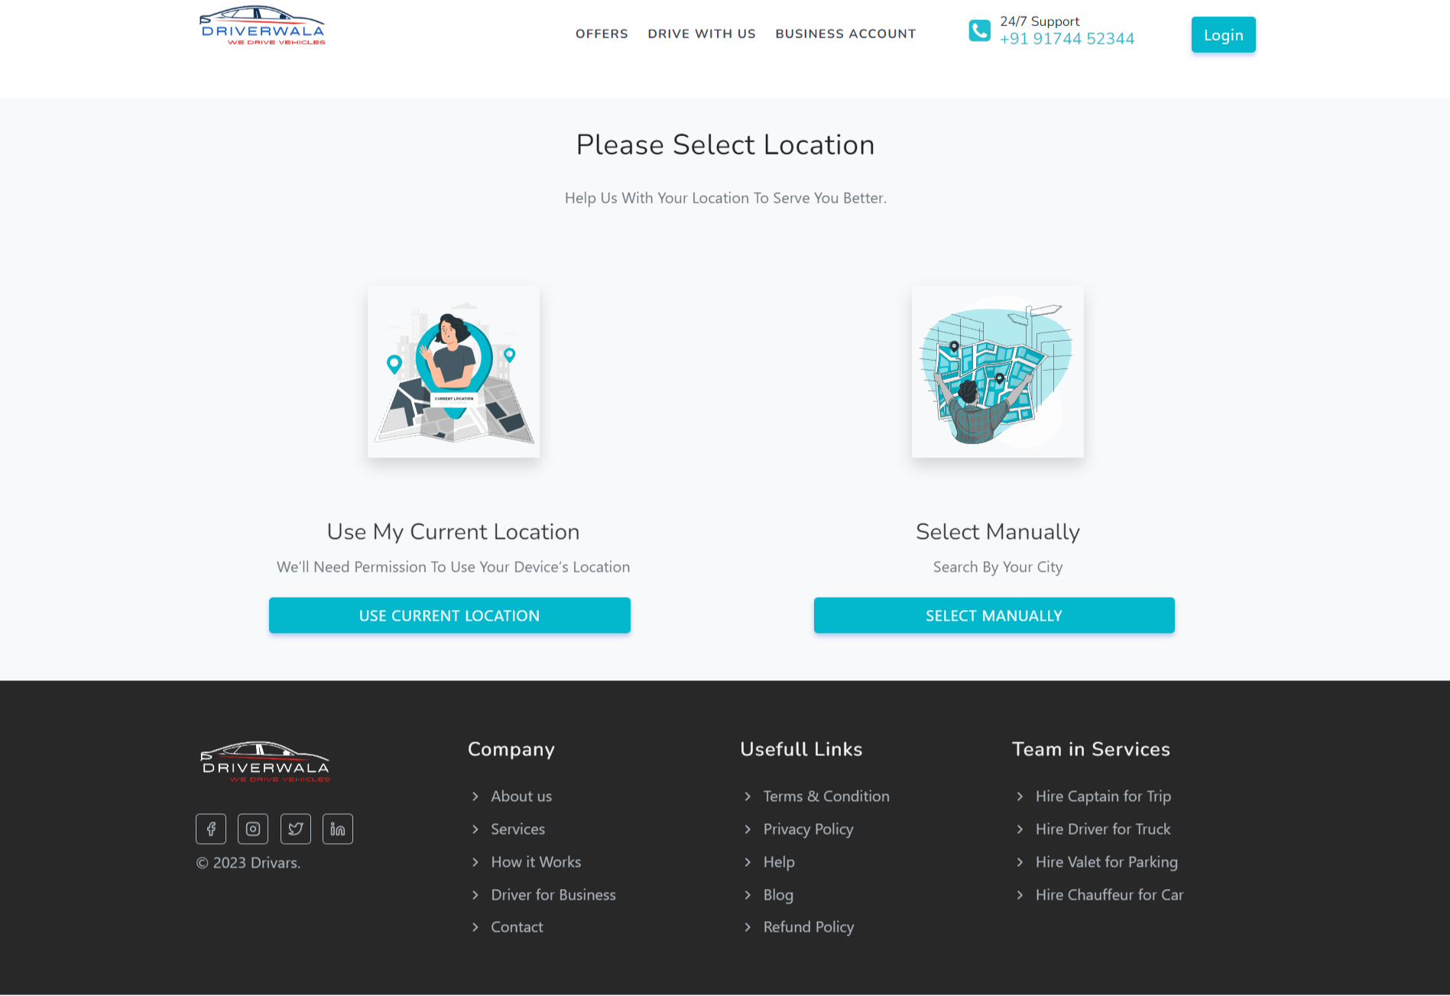
Main page of our website(customer side screen layout)
1)

Slide 29
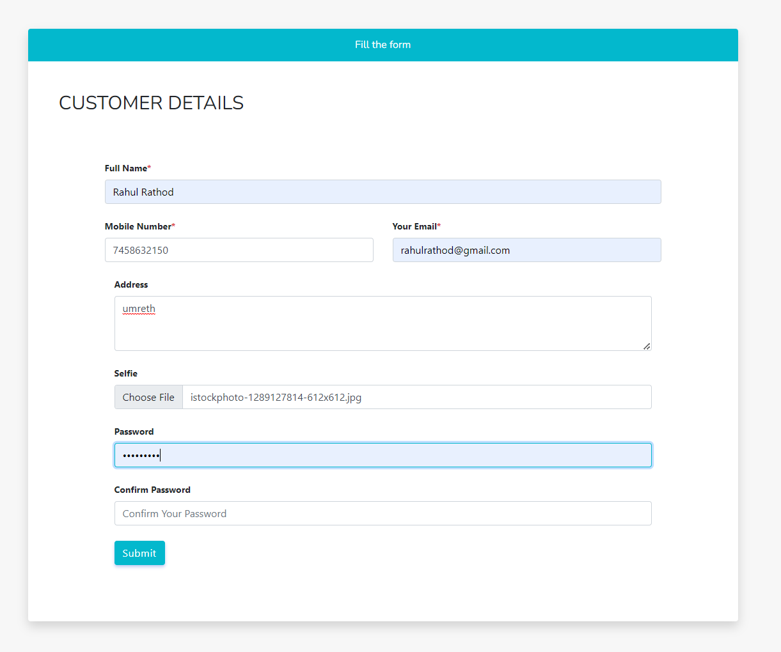
Customer Registration
2)

Slide 30
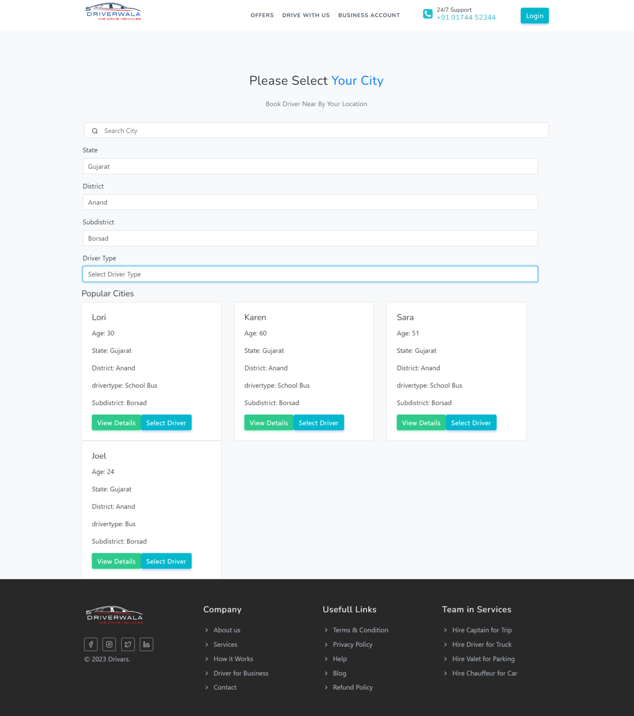
Select Driver
3)

Slide 31
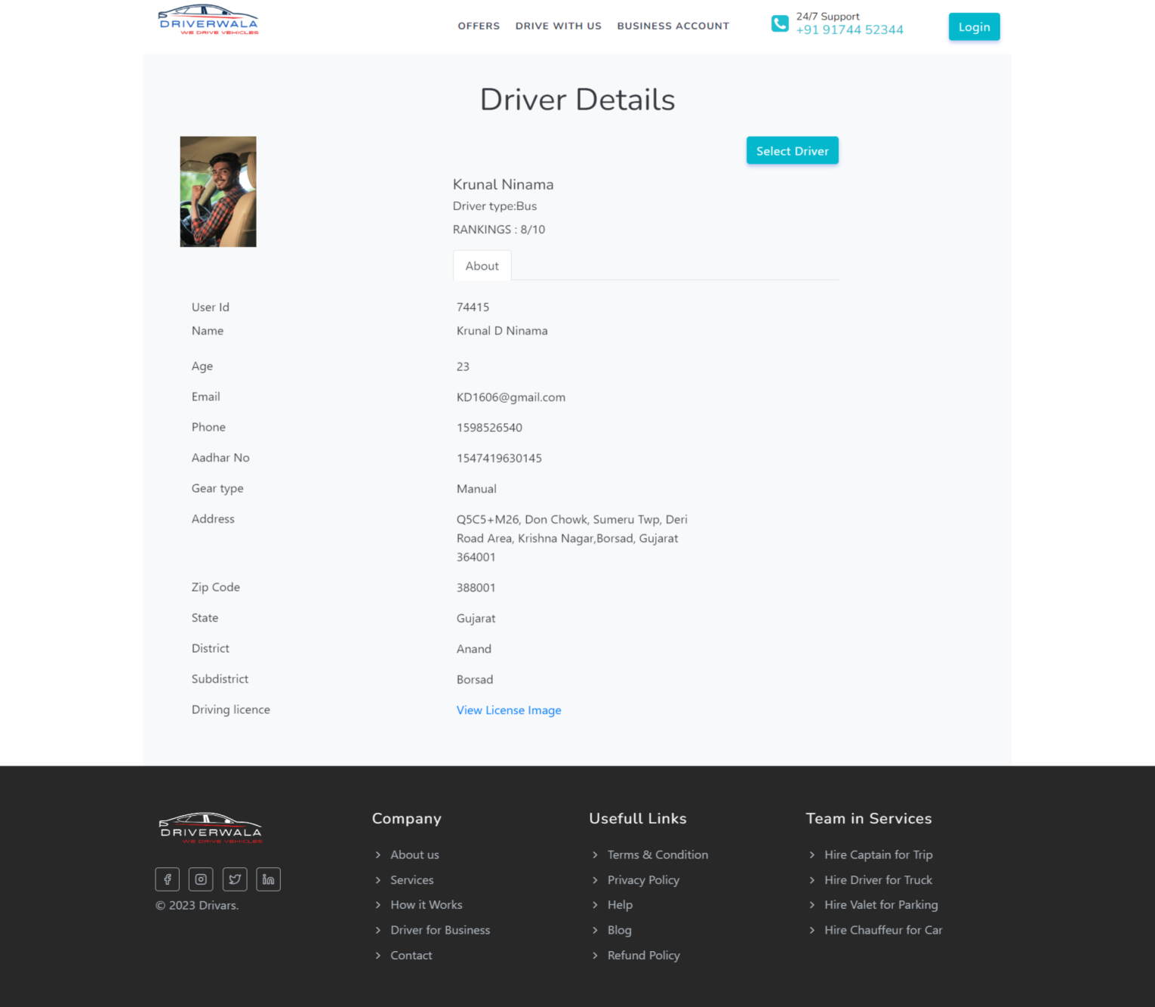
Driver Details
4)

Slide 32
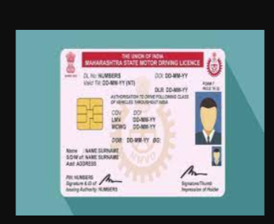
Driving License
5)

Slide 33
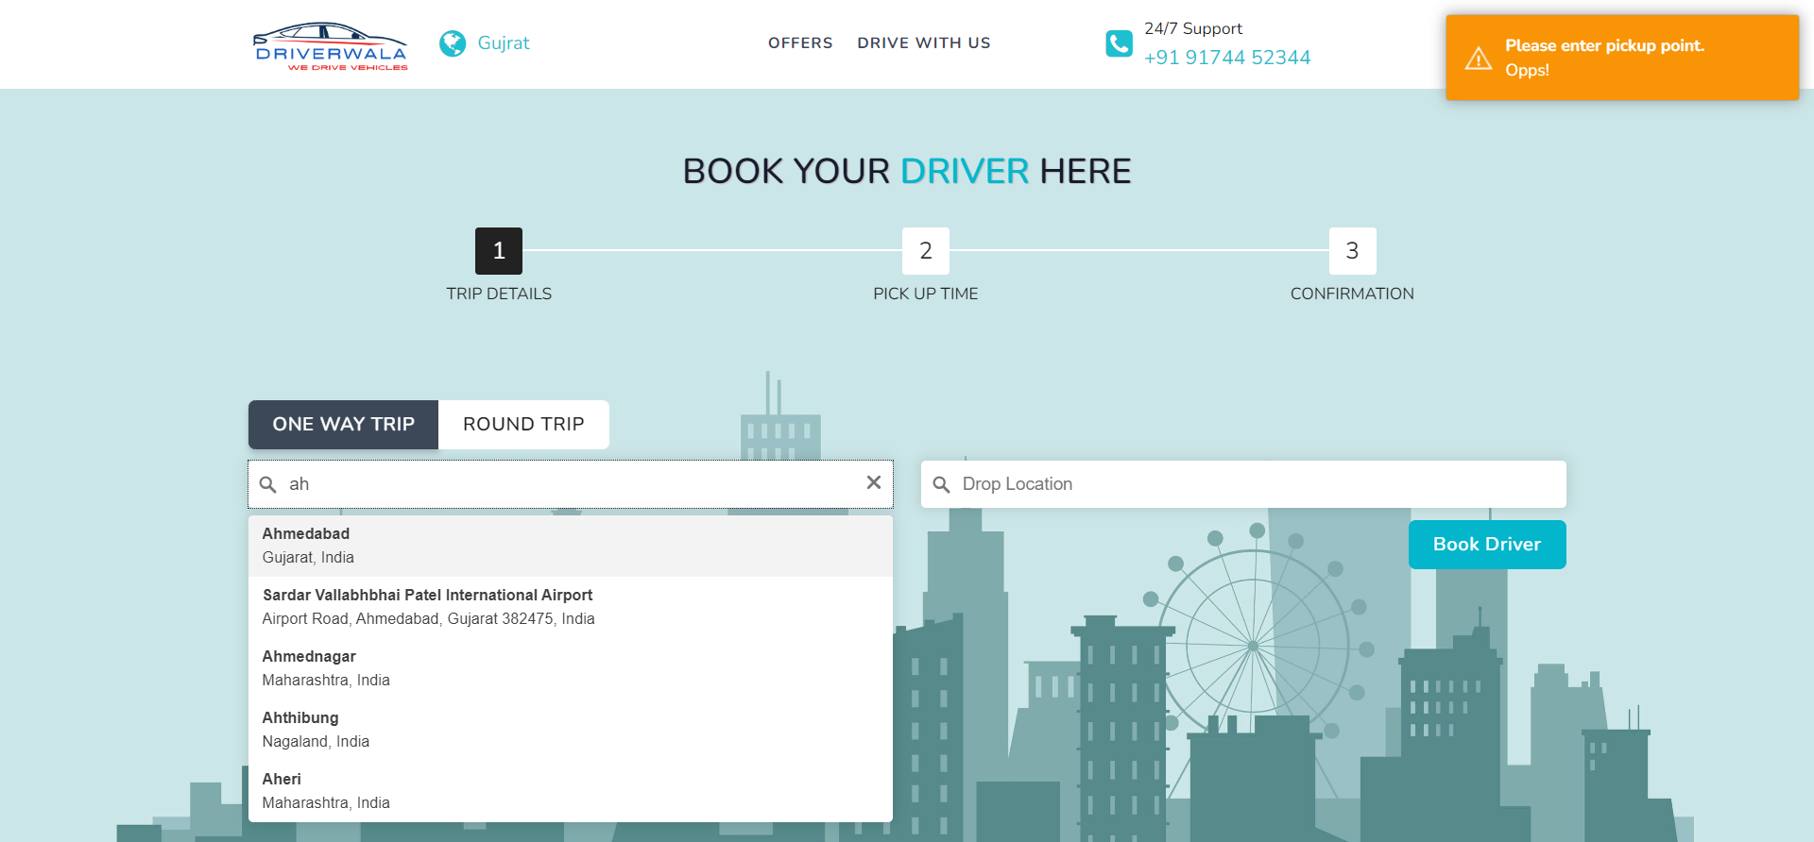
Trip Detail
6)

Slide 34
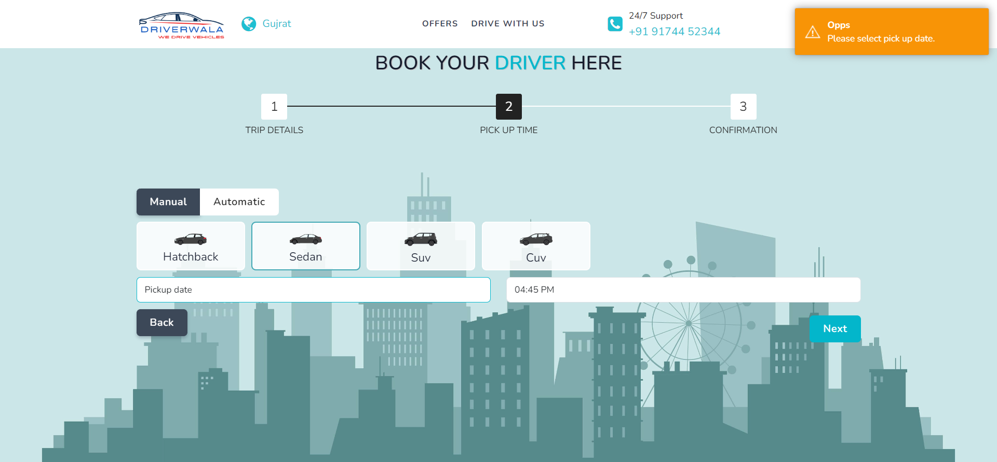
Pick up Time
7)

Slide 35
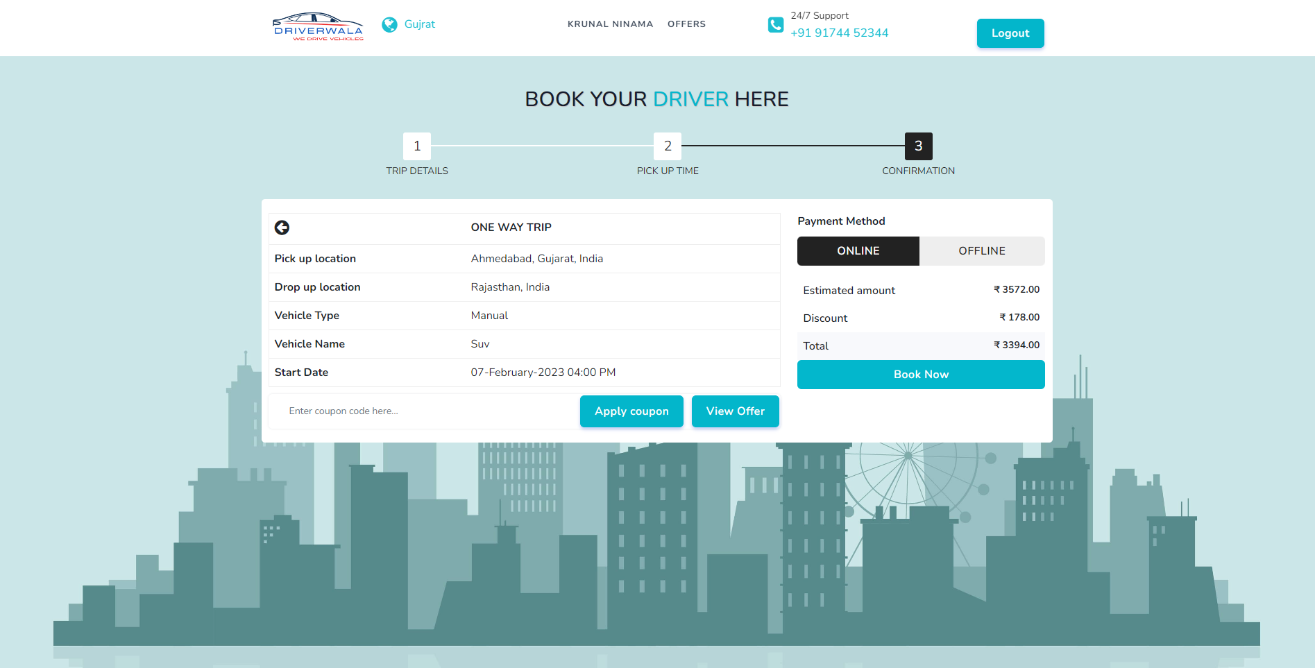
Trip Confirmation
8)

Slide 36
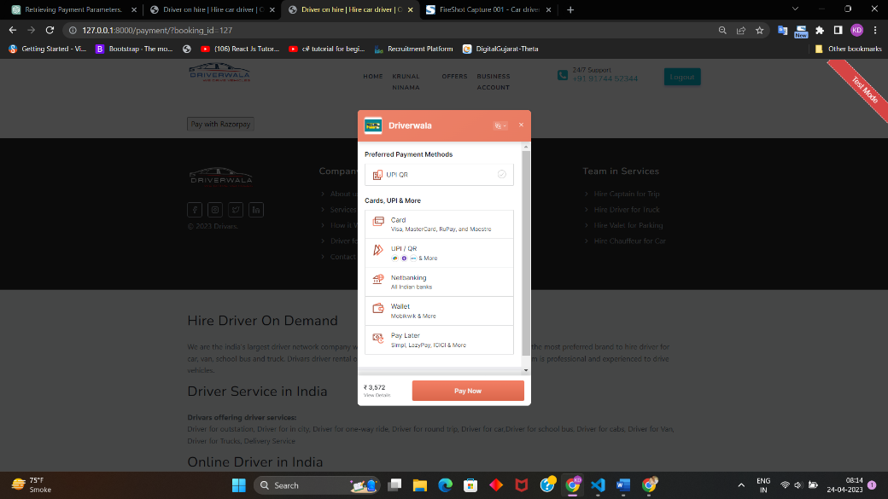
Payment
9)

Slide 37
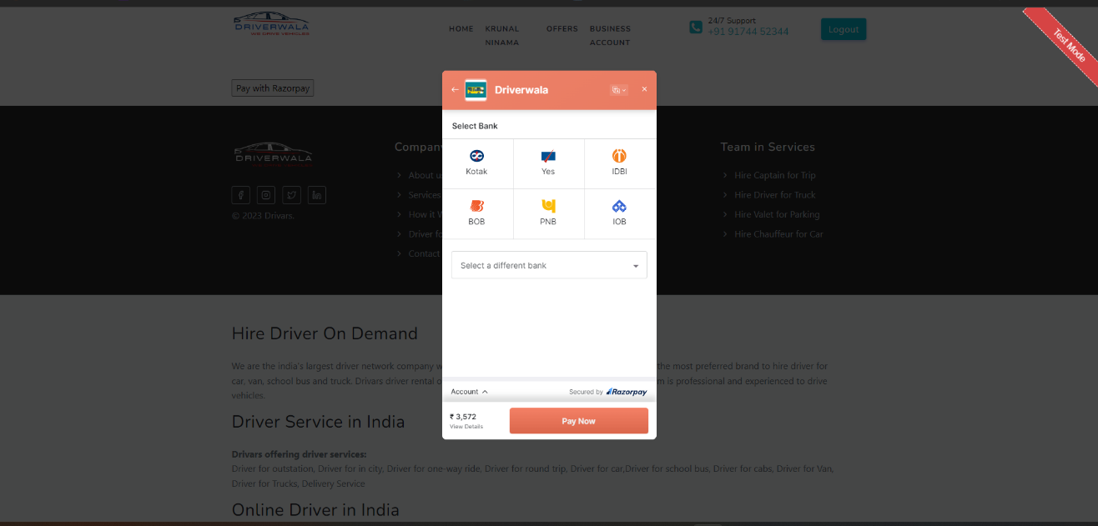
Payment
10)

Slide 38
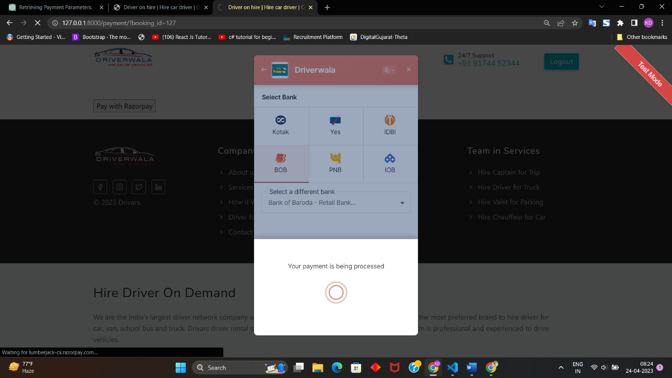
Payment
11)

Slide 39
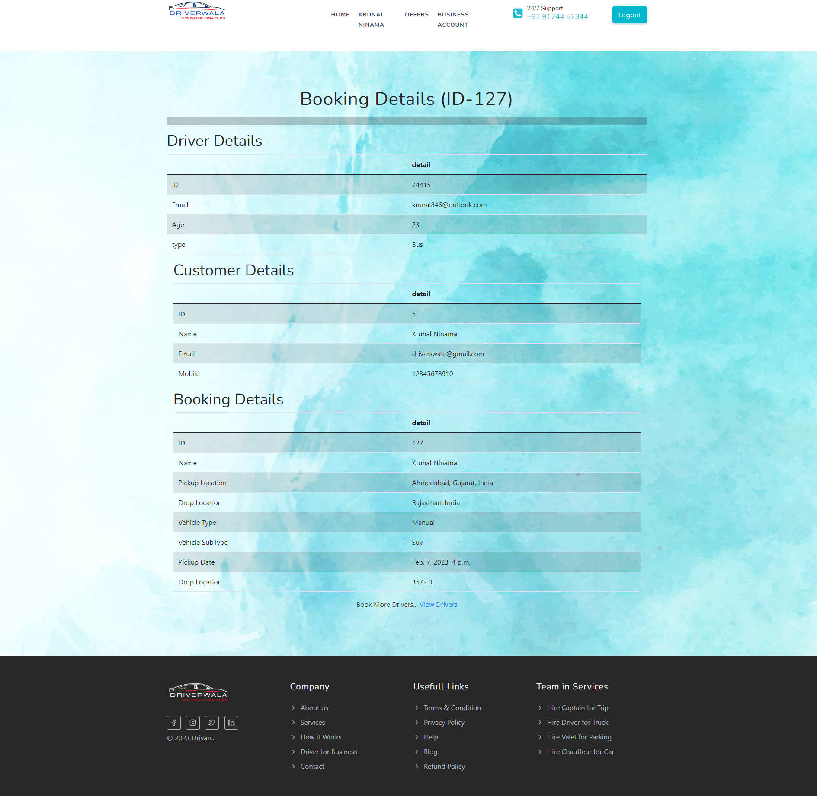
Booking Details
12)

Slide 40
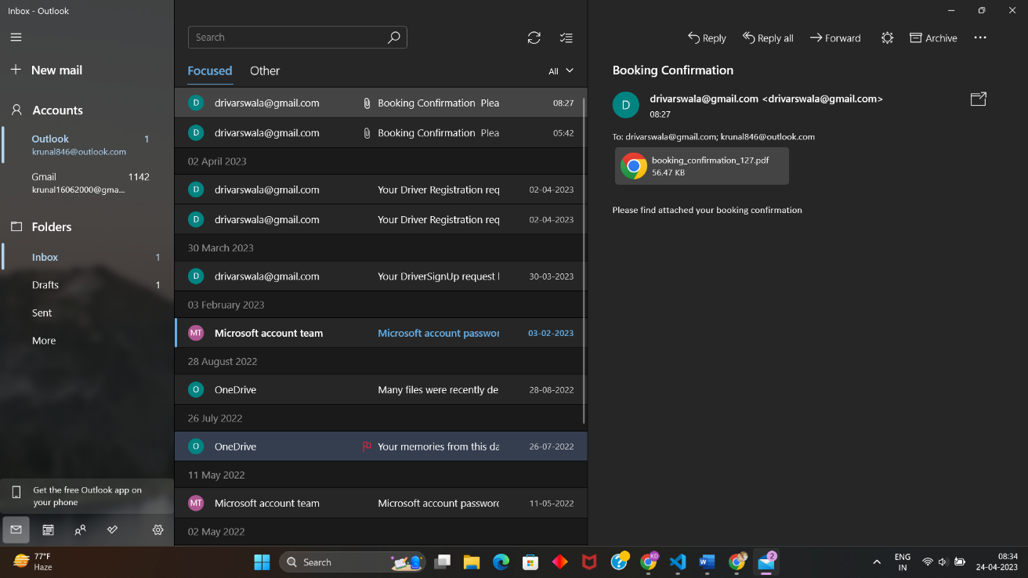
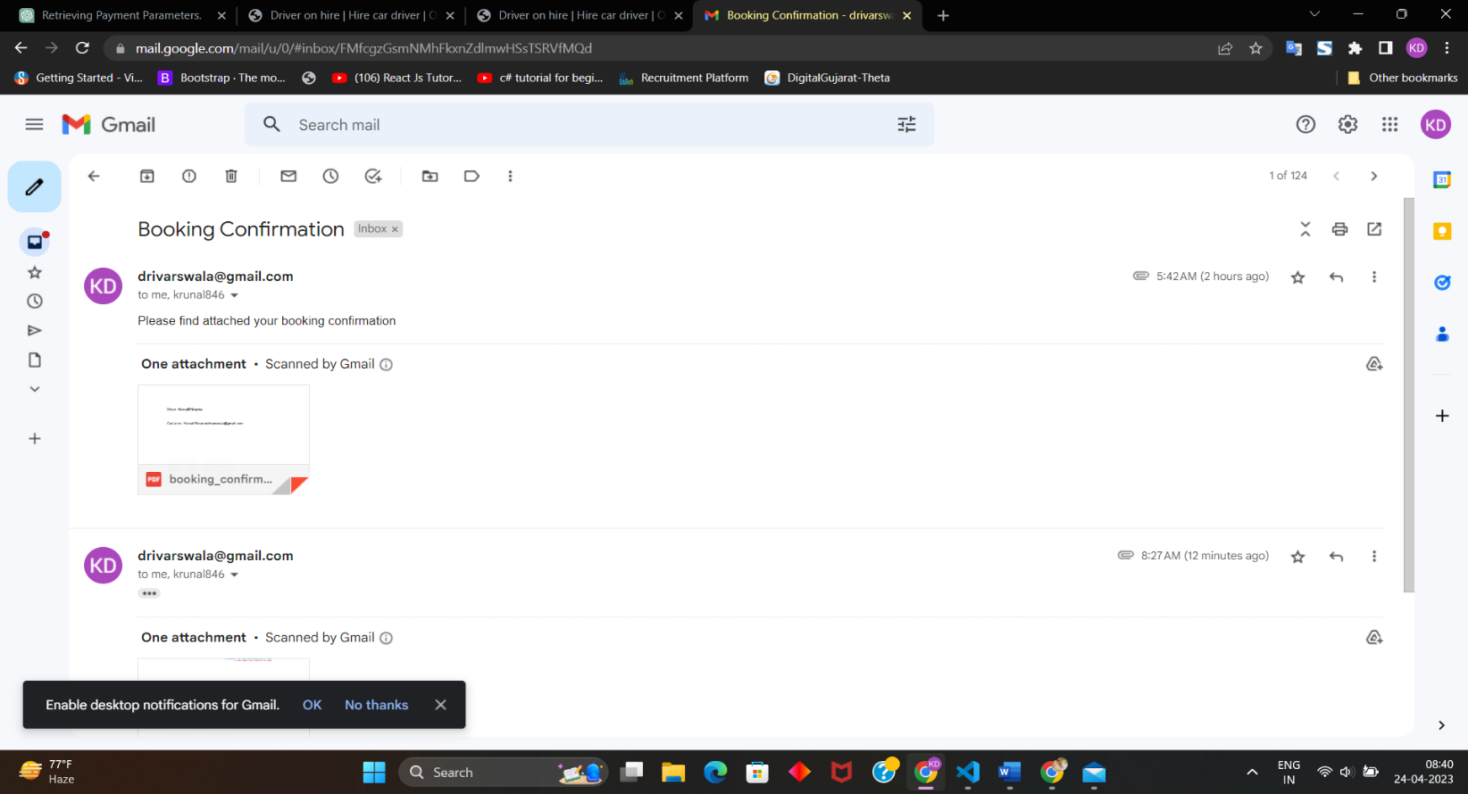
Send pdf Customer and Driver
13)

Slide 41
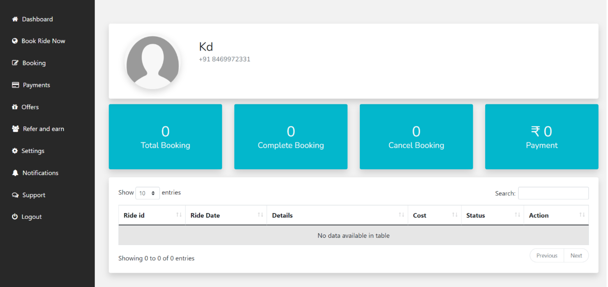
Customer Dashboard
14)

Slide 42
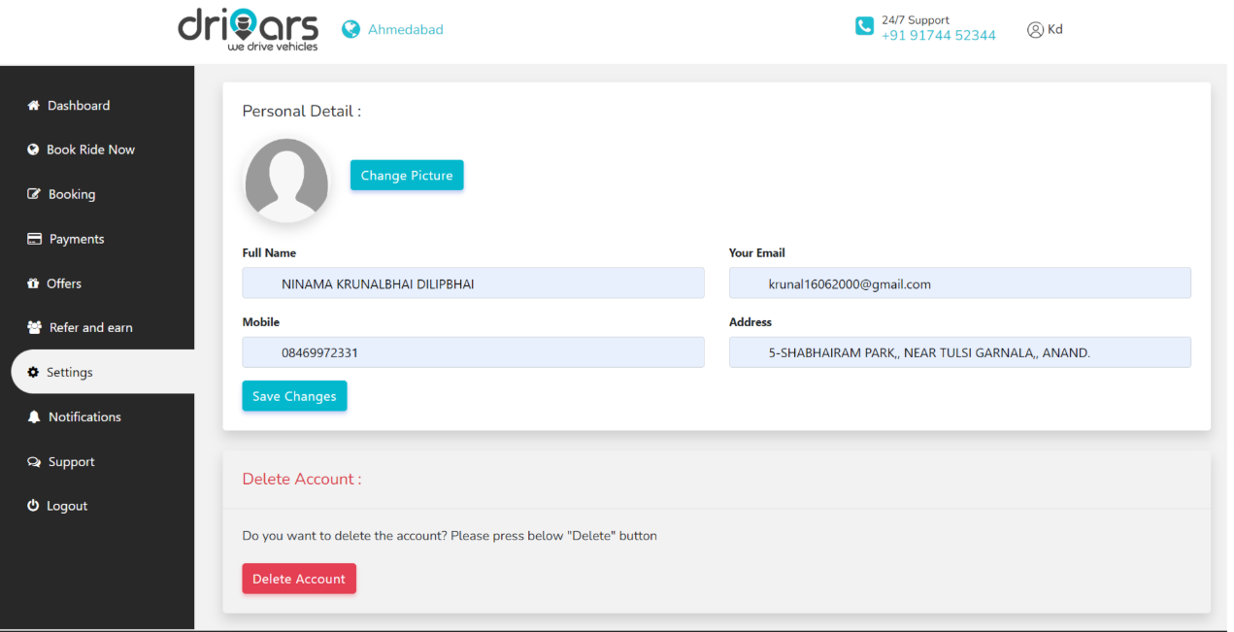
Edit Profile
15)

Slide 43
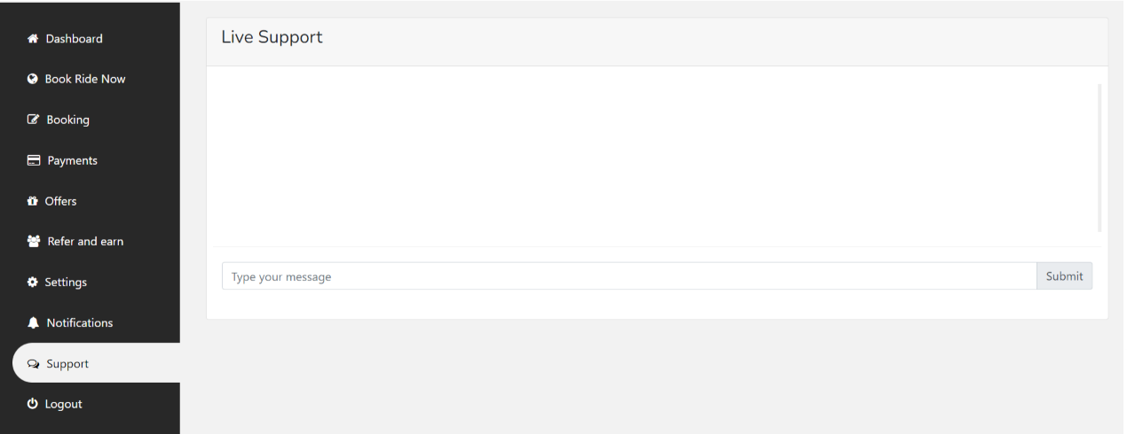
Support
16)

Slide 44
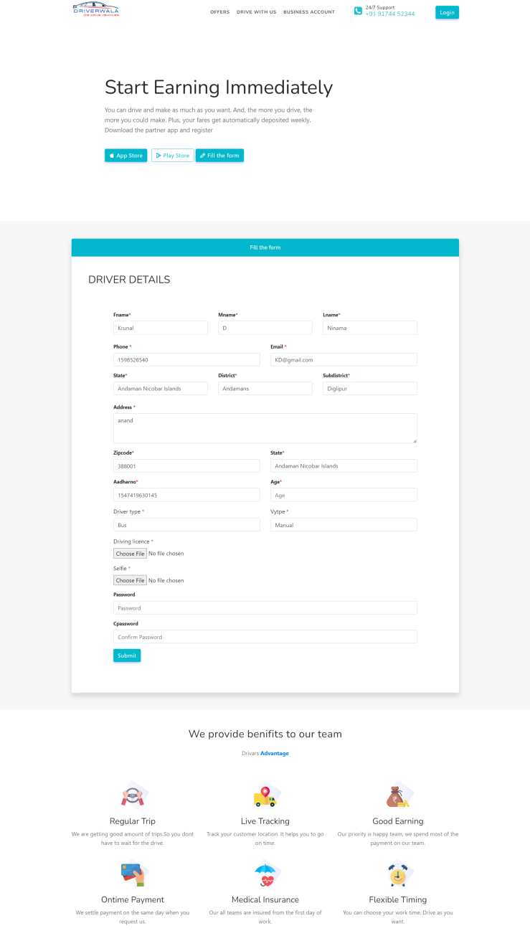
Driver Registraion(DRIVER SIDE SCREEN LAYOUT )
17)

Slide 45
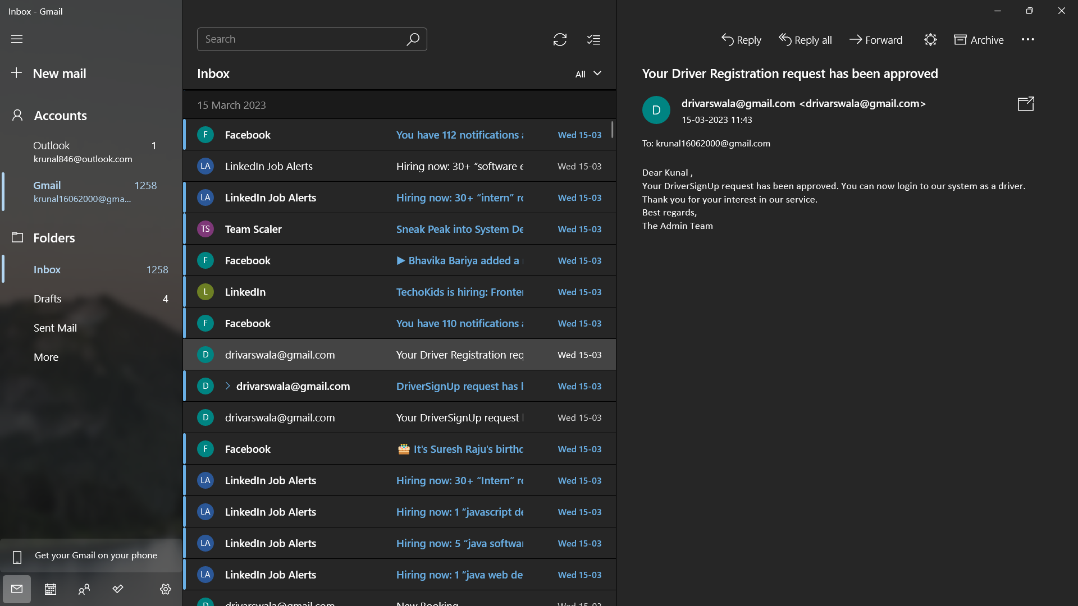
Approve Registration
18)

Slide 46
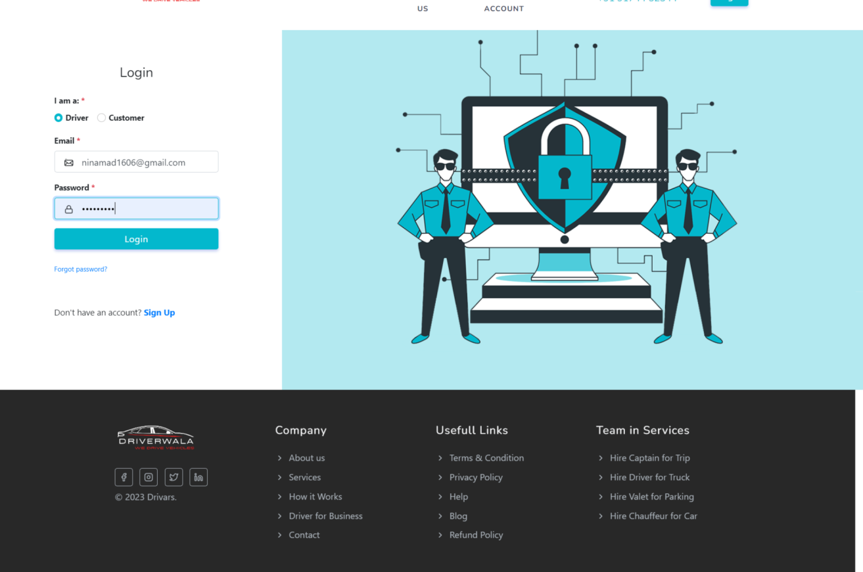
Login Page
19)

Slide 47
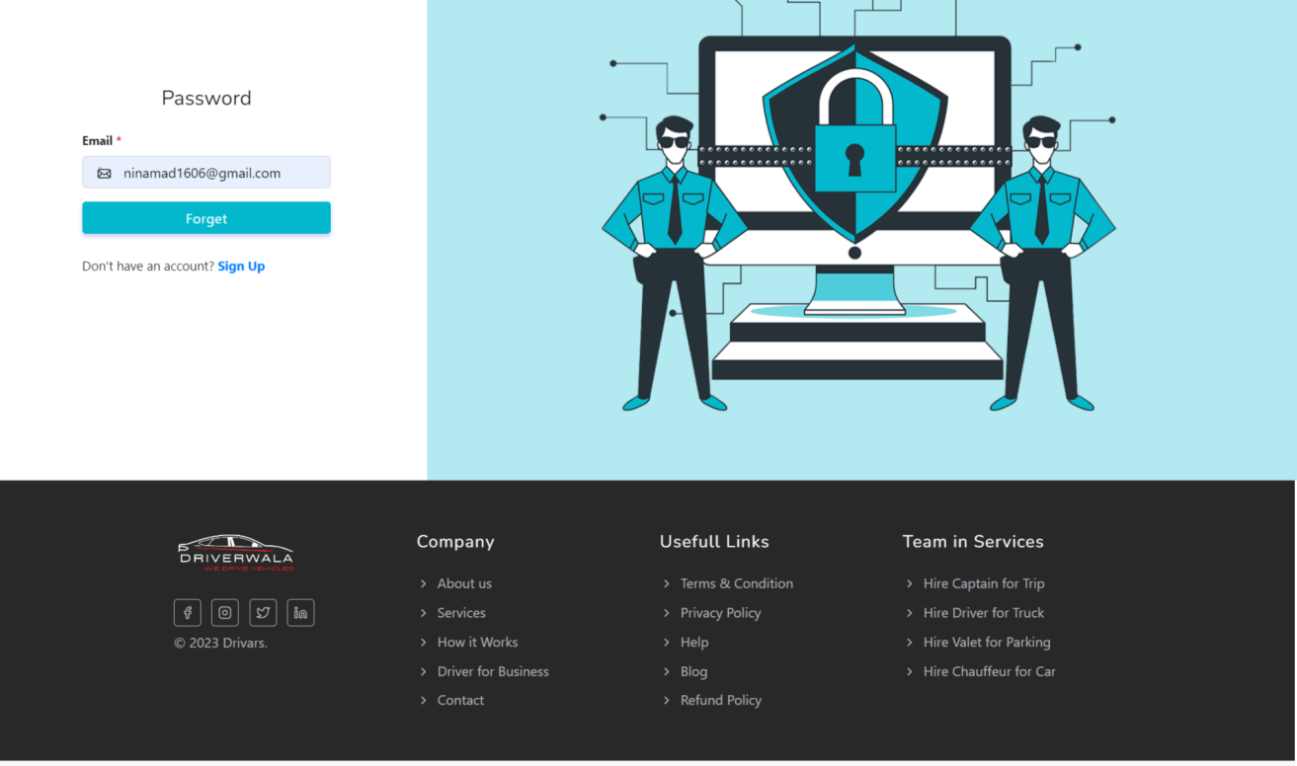
Forget Password
20)

Slide 48
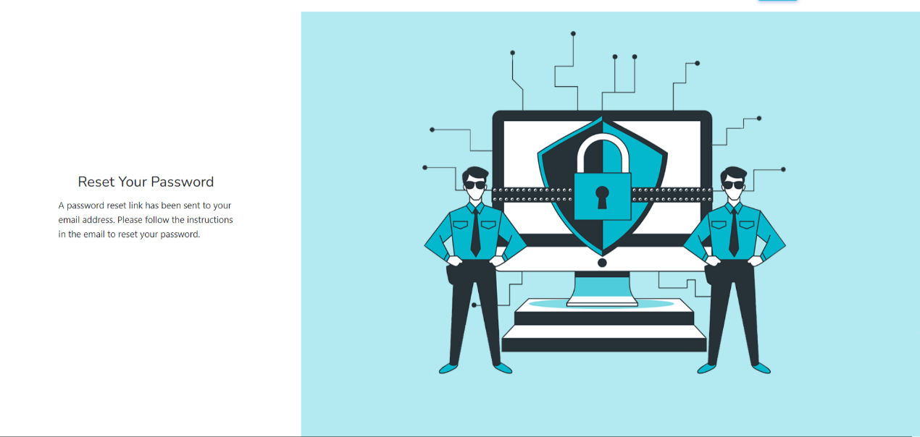
Forget password msg
21)

Slide 49
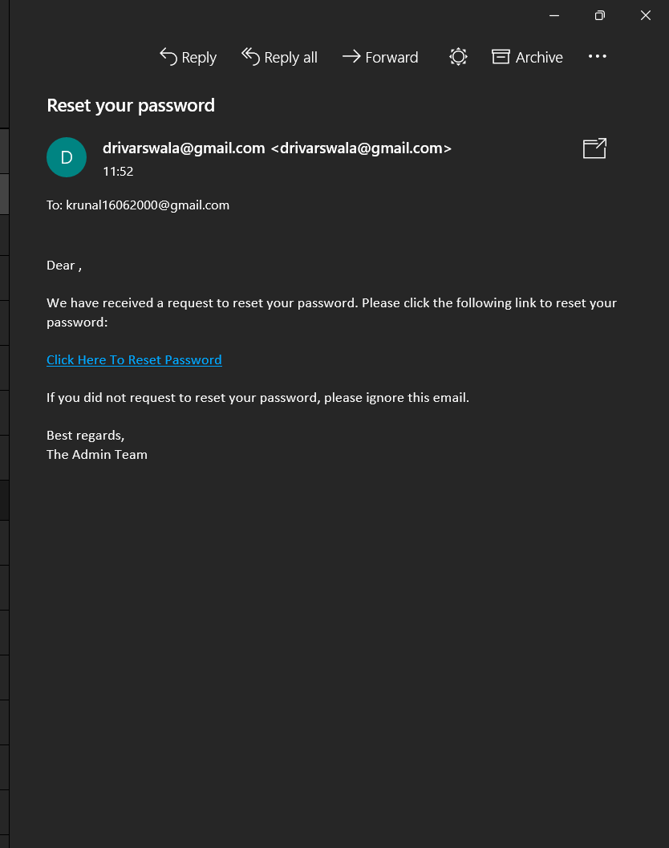
Forget password mail
22)

Slide 50
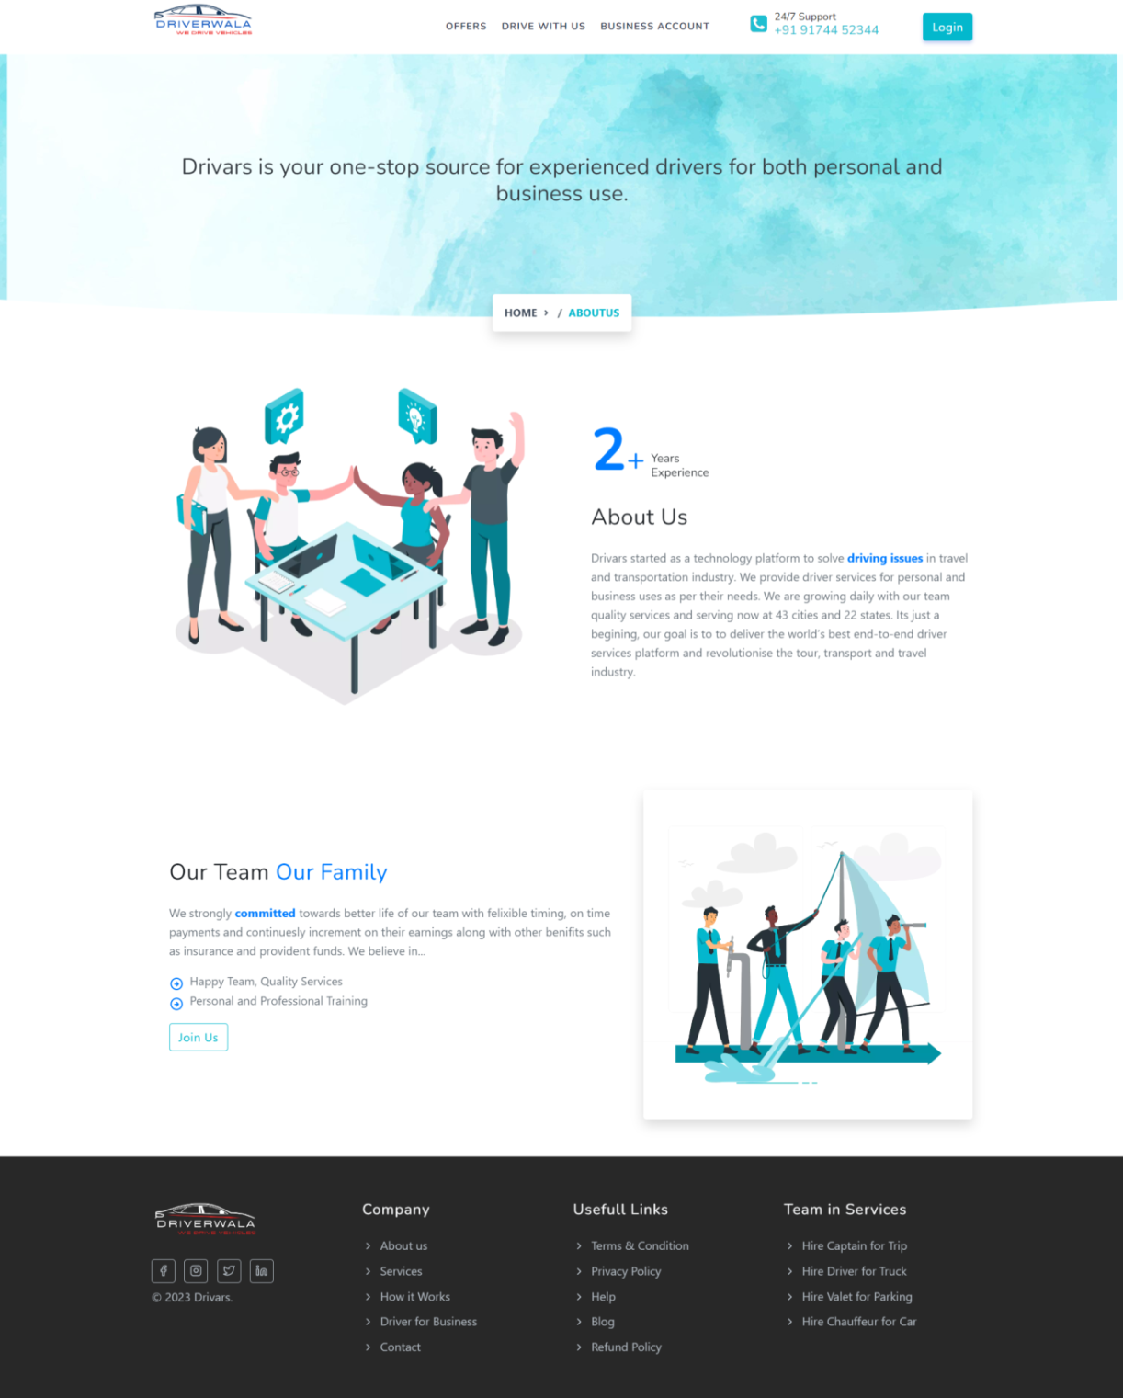
About_Us
23)

Slide 51
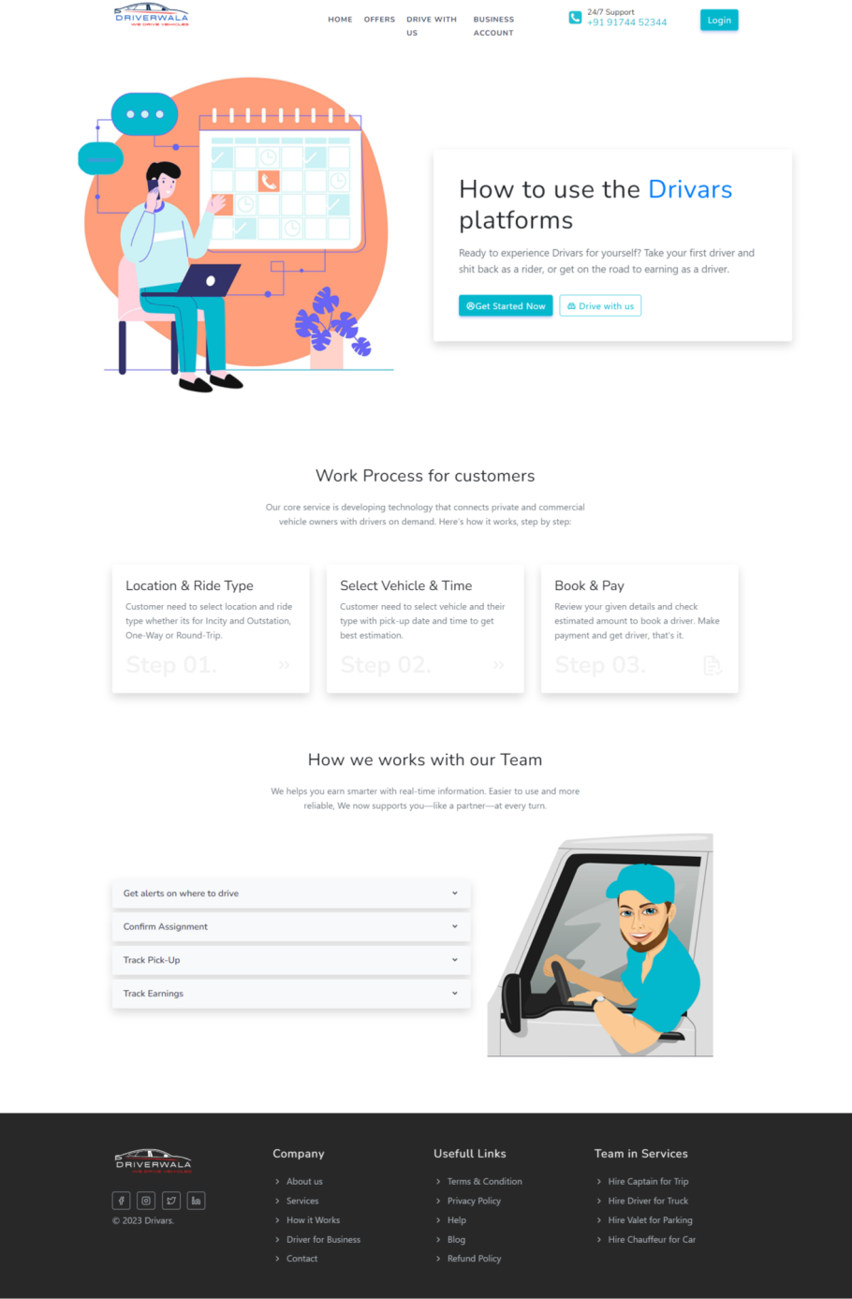
How it Works
24)

Slide 52
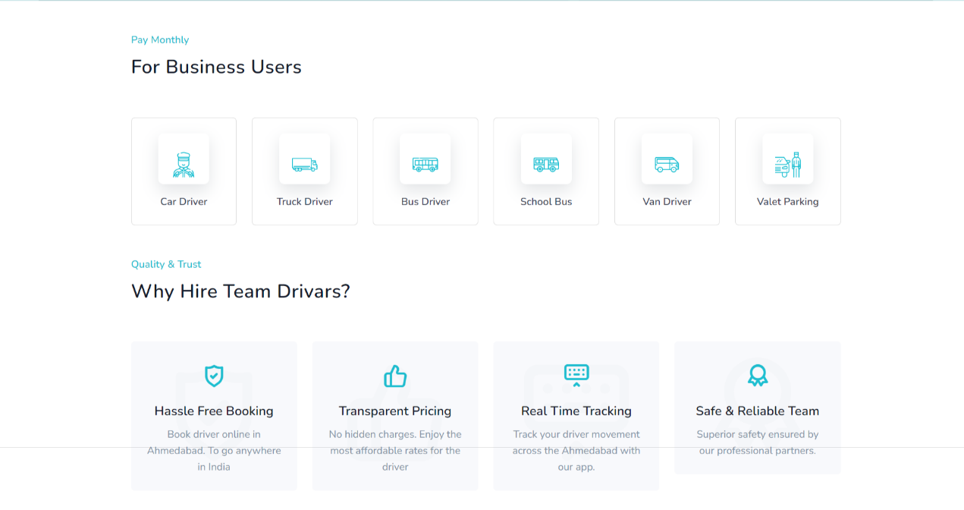
Business
25)

Slide 53
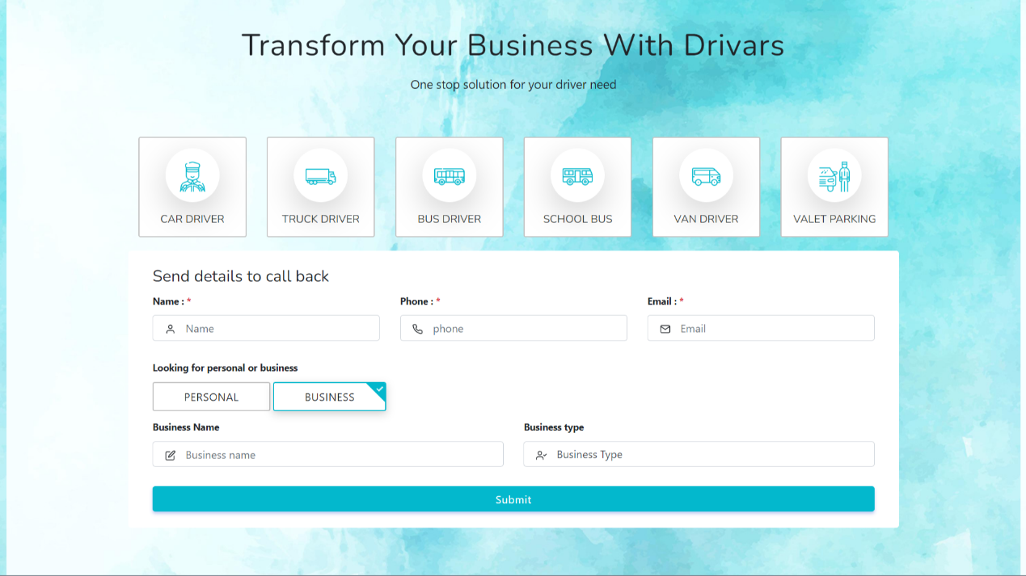
Business With Drivers
26)

Slide 54
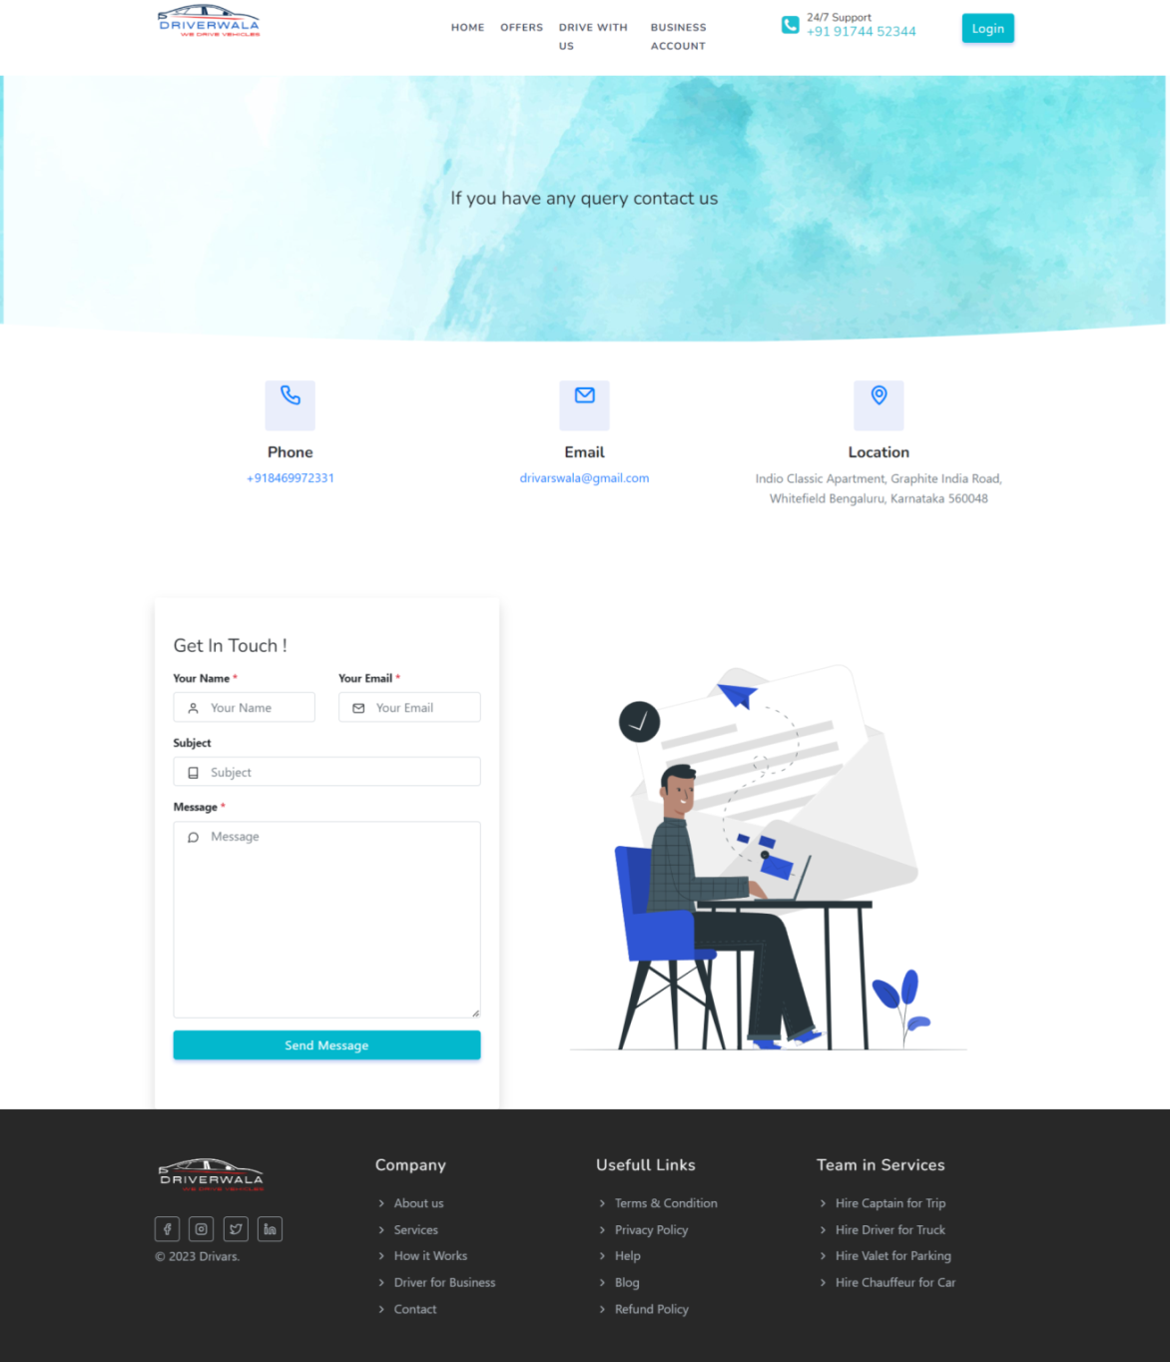
Contact-us
27)

Slide 55
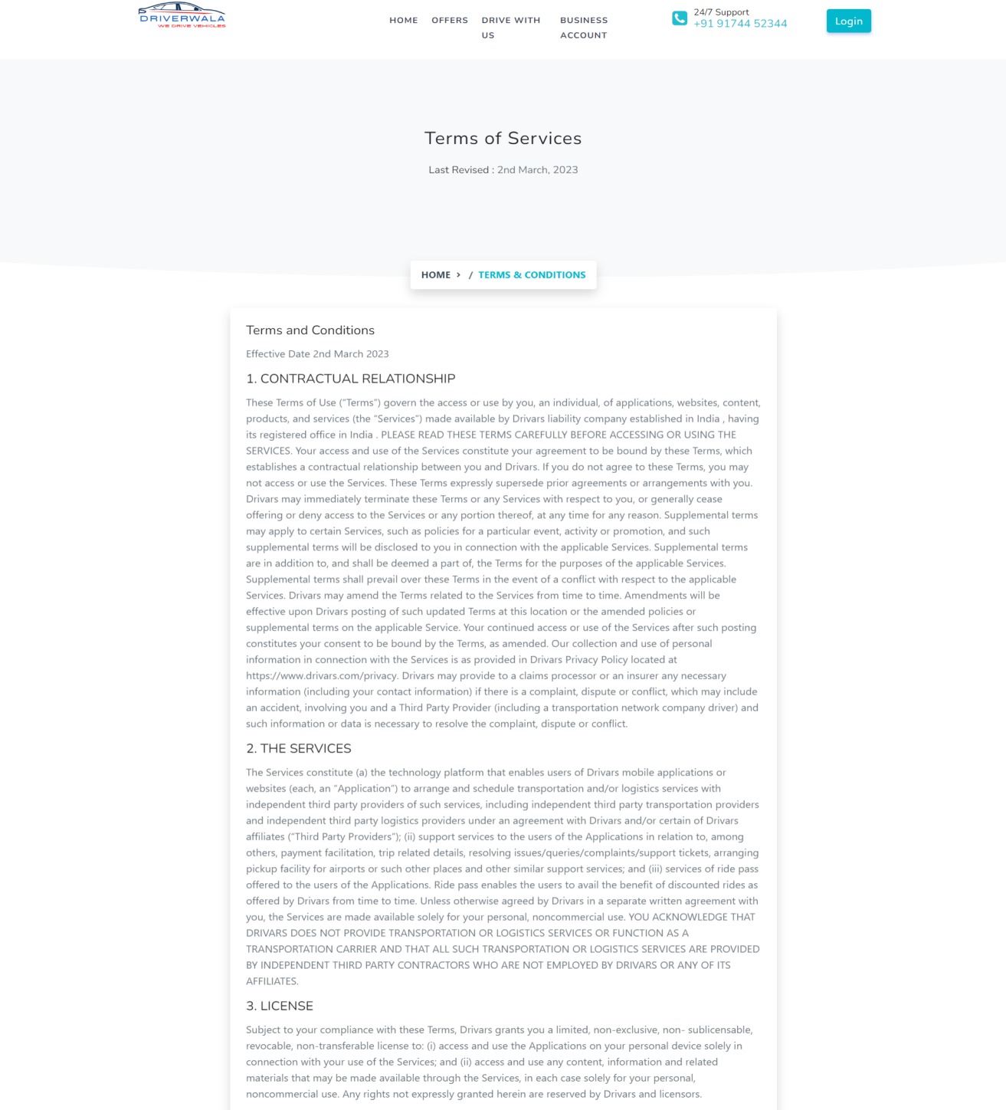
Terms and Conditions
28)

Slide 56
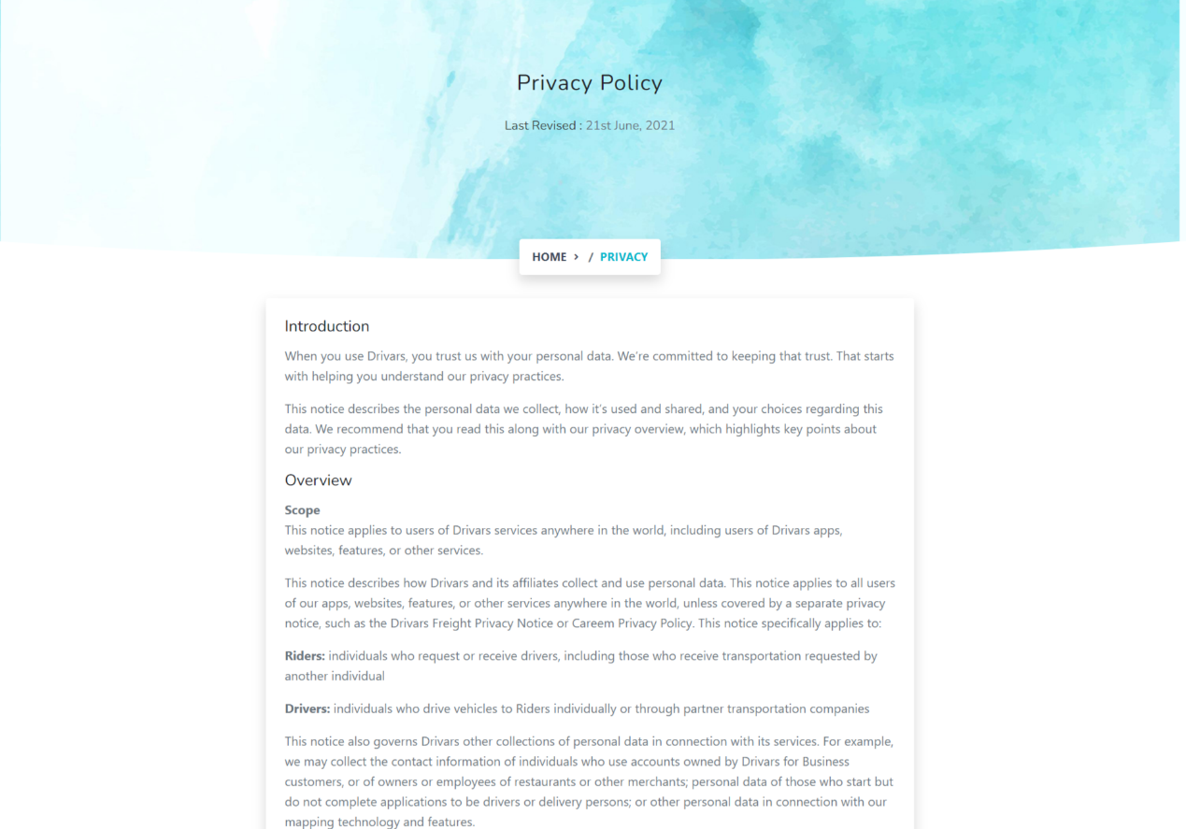
Privacy
29)

Slide 57
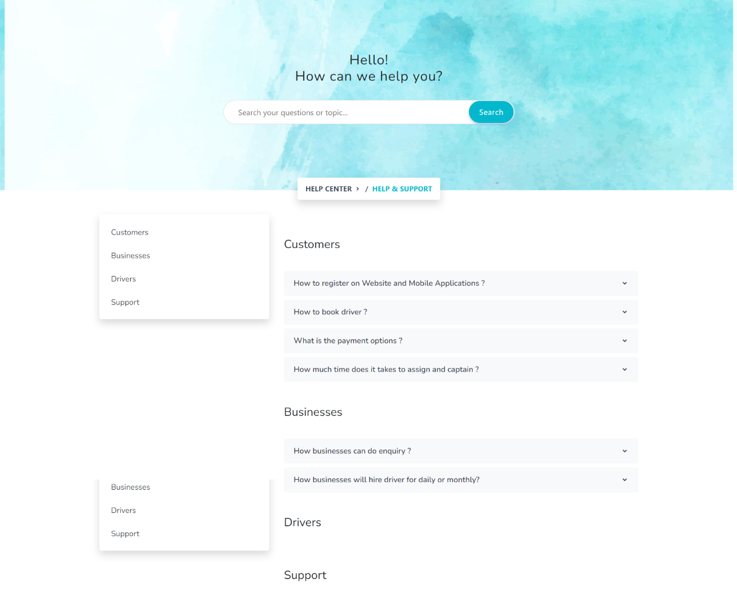
Help And Support
30)

Slide 58
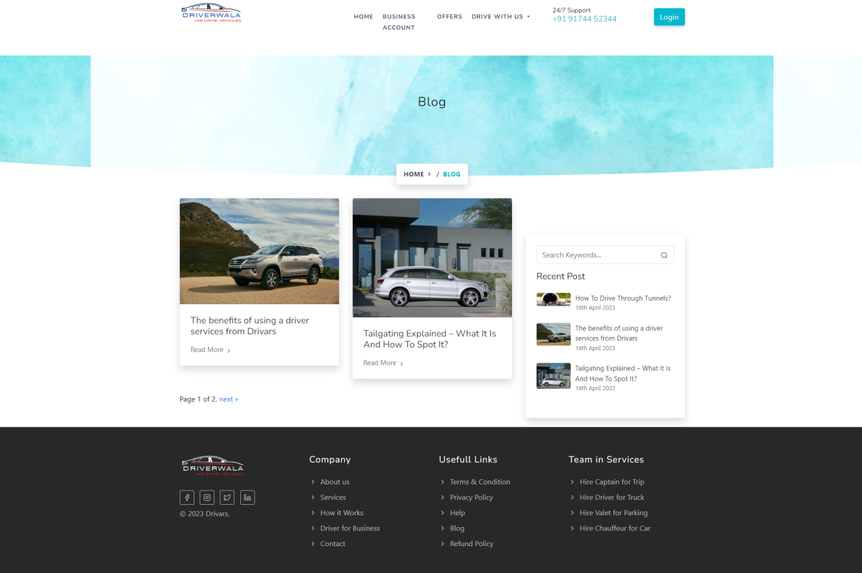
Blog
31)

Slide 59
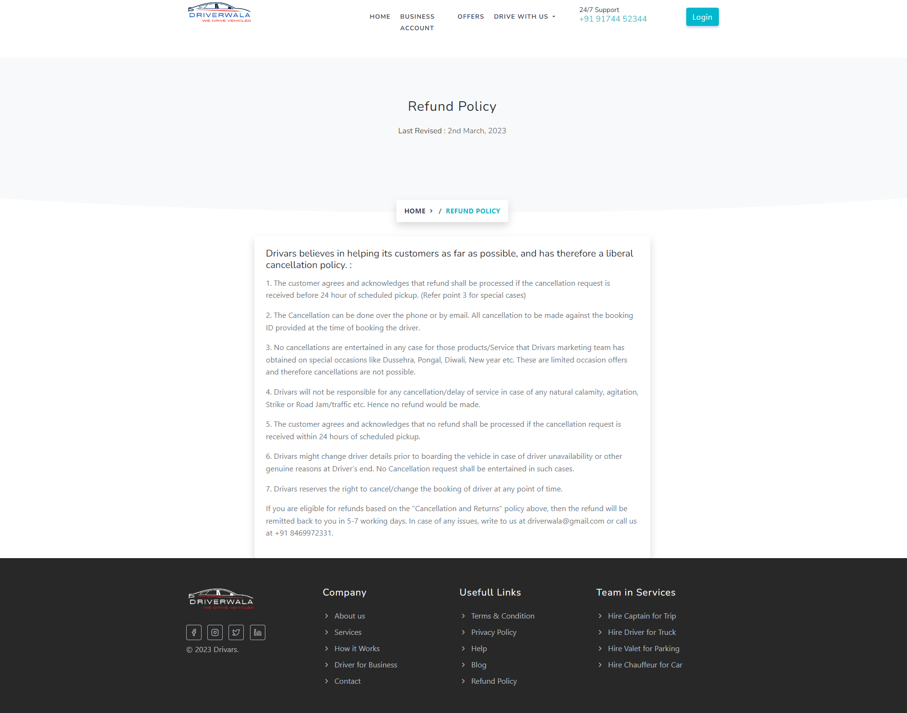
Refund Policy
32)

Slide 60
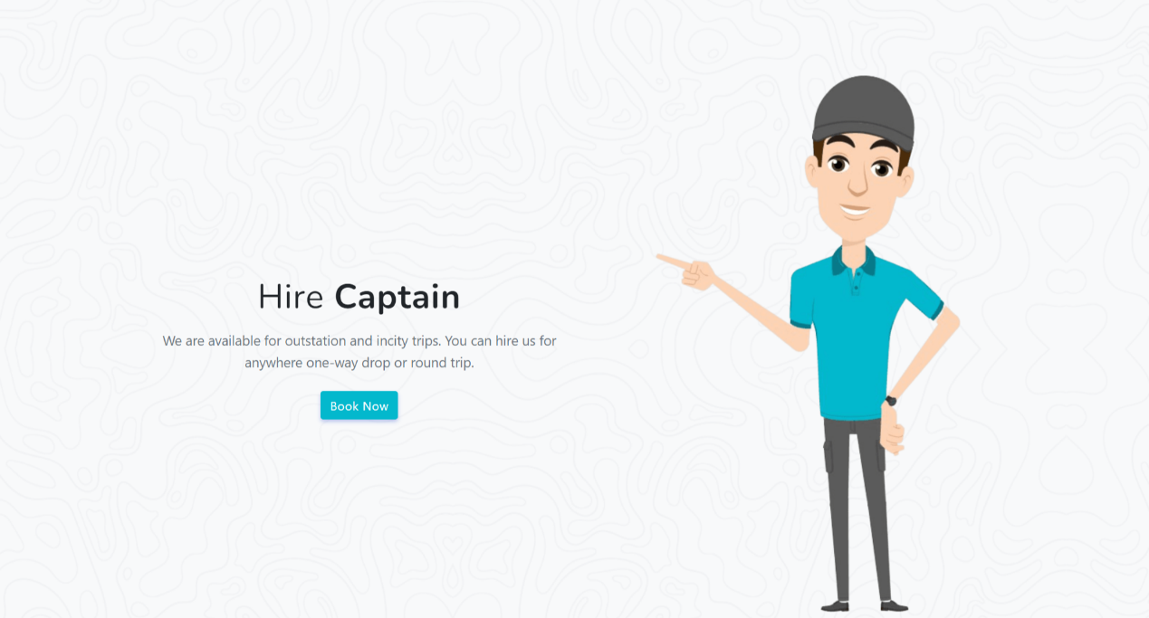
Captain
33)

Slide 61
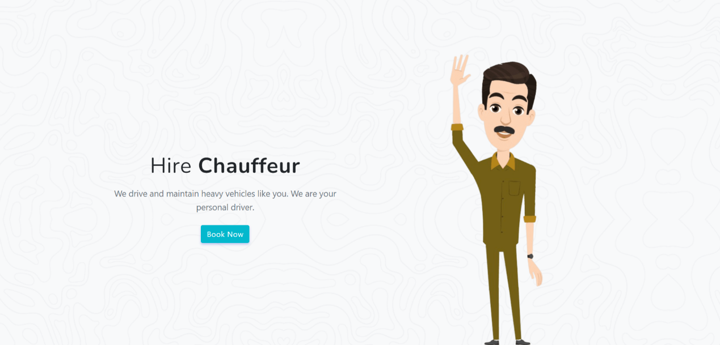
Chauffeur
34)

Slide 62

Valet
35)

Slide 63
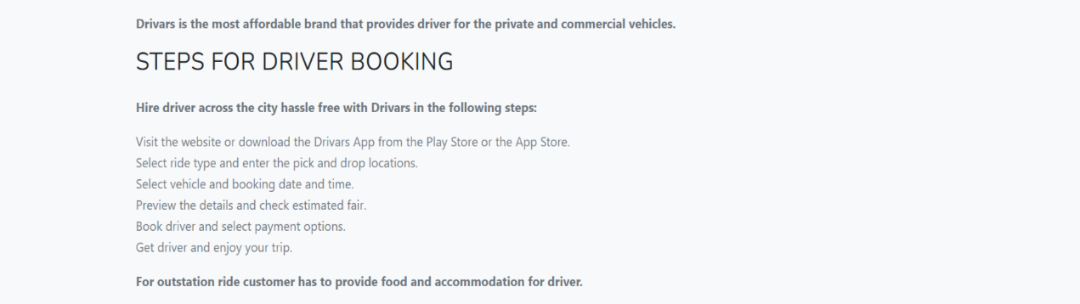
Steps for Driver Booking
36)

Slide 64
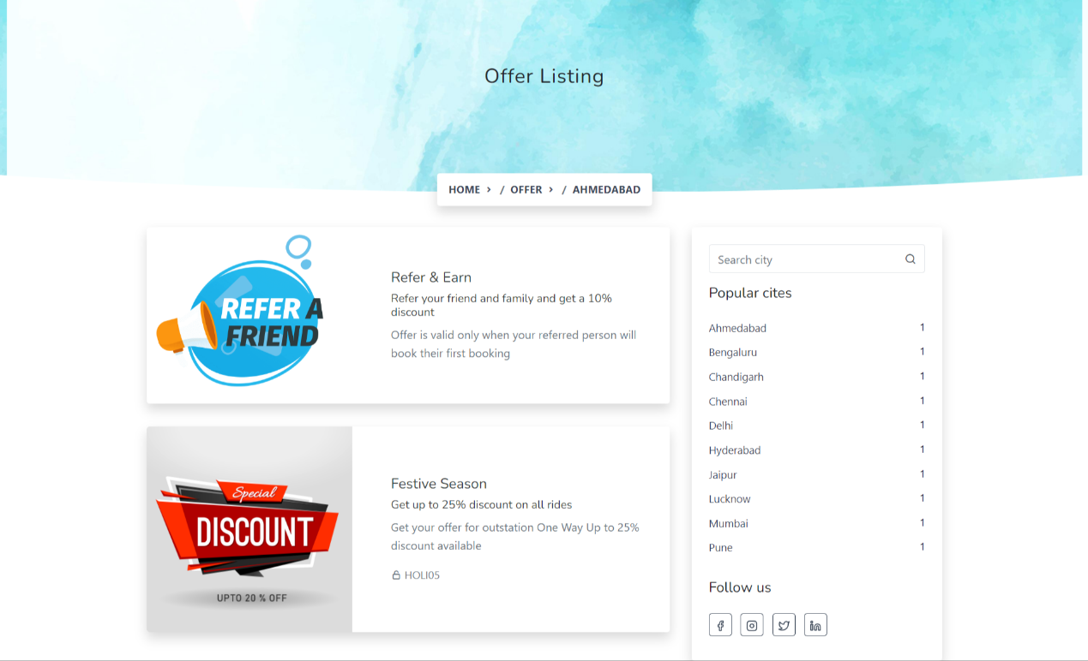
Offers
37)

Slide 65
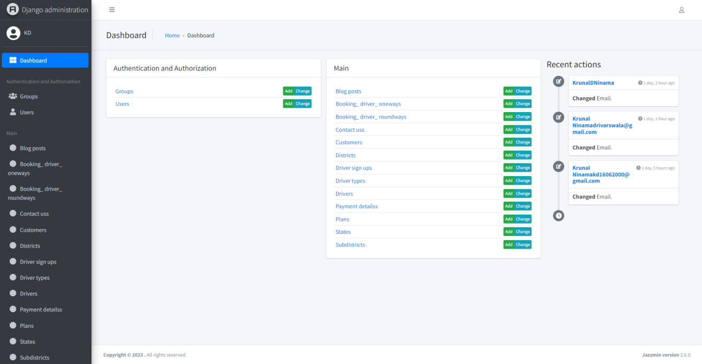
Admin Panel
1) Admin Dashboard

Slide 66
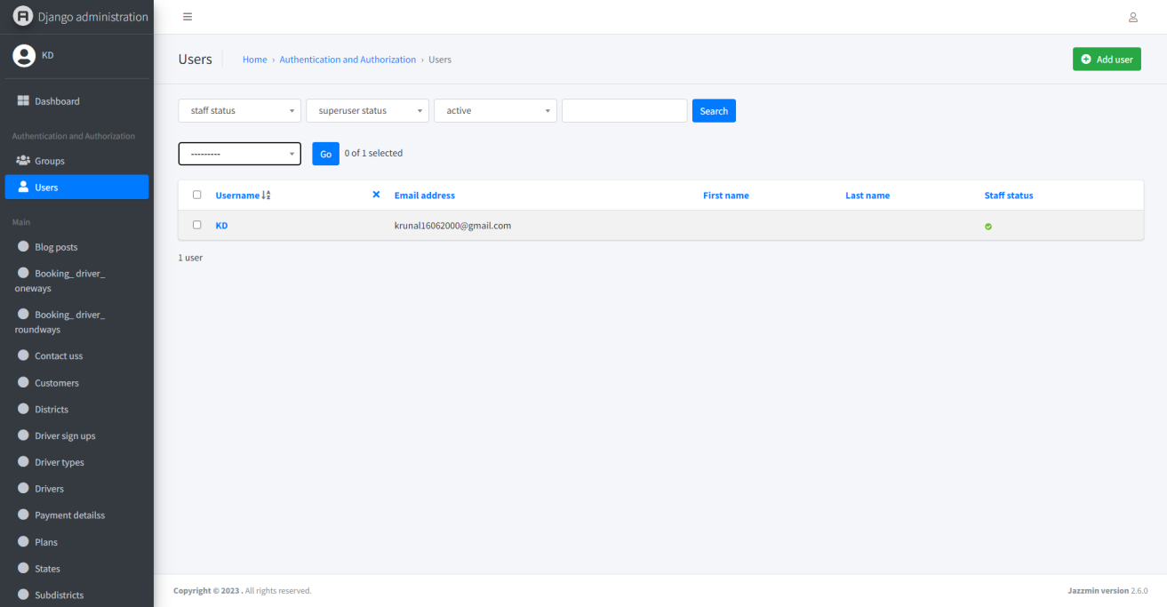
User
2)

Slide 67
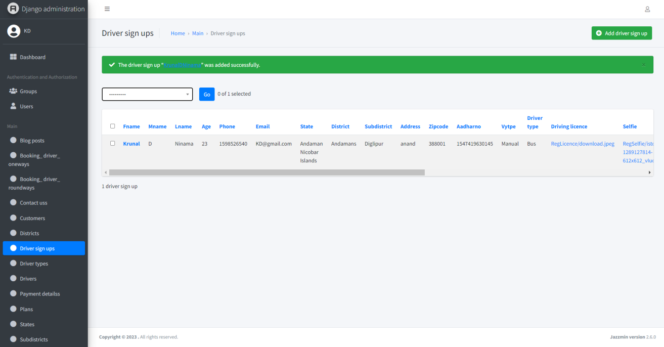
Driver Sign-Up
3)

Slide 68
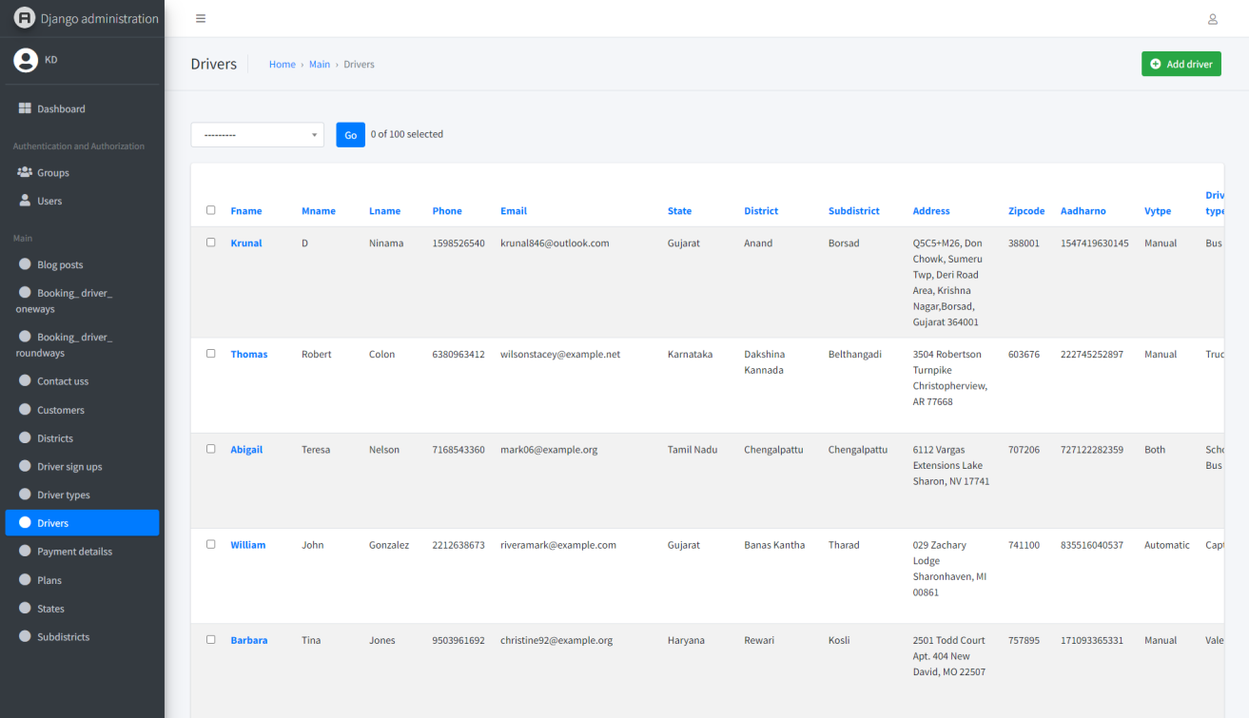
Approved Driver
4)

Slide 69
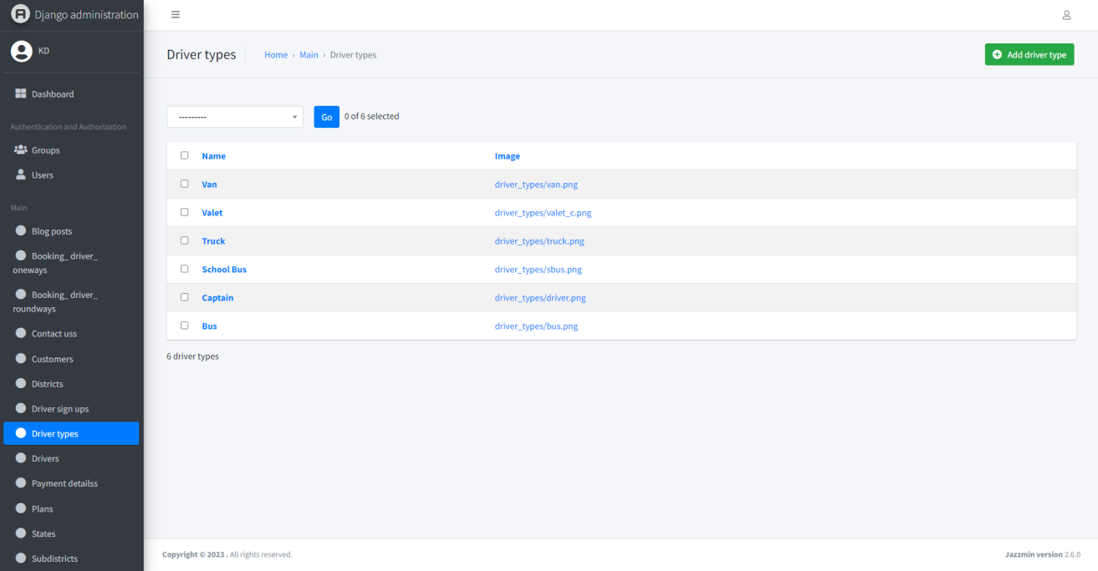
Driver Type
5)

Slide 70
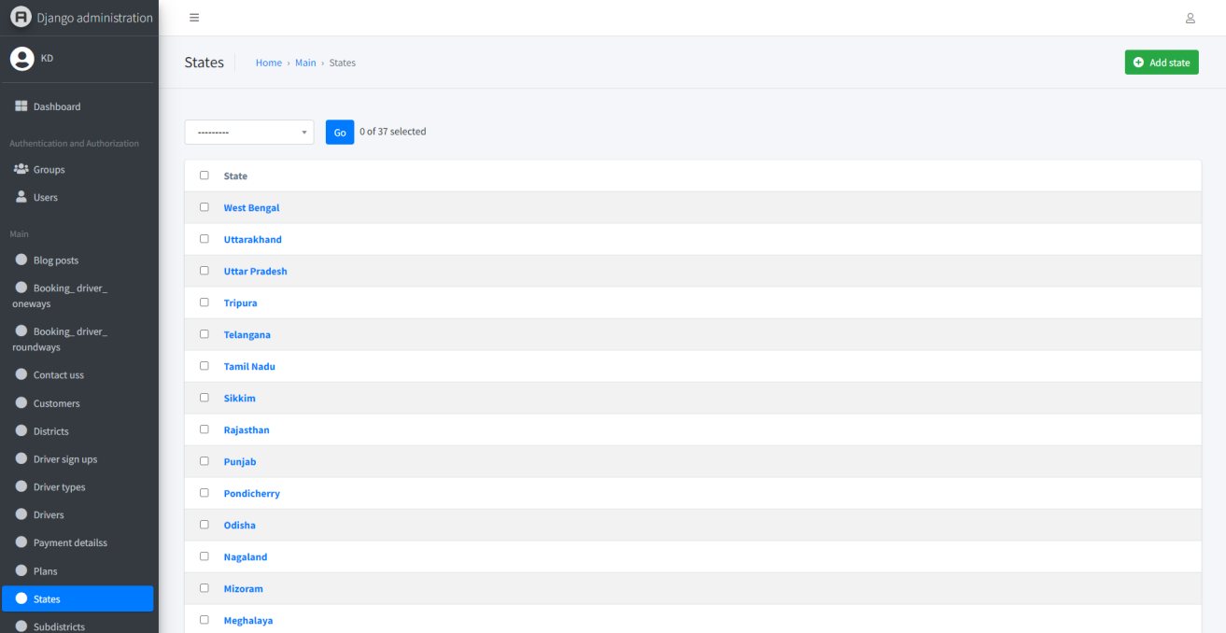
State
6)

Slide 71
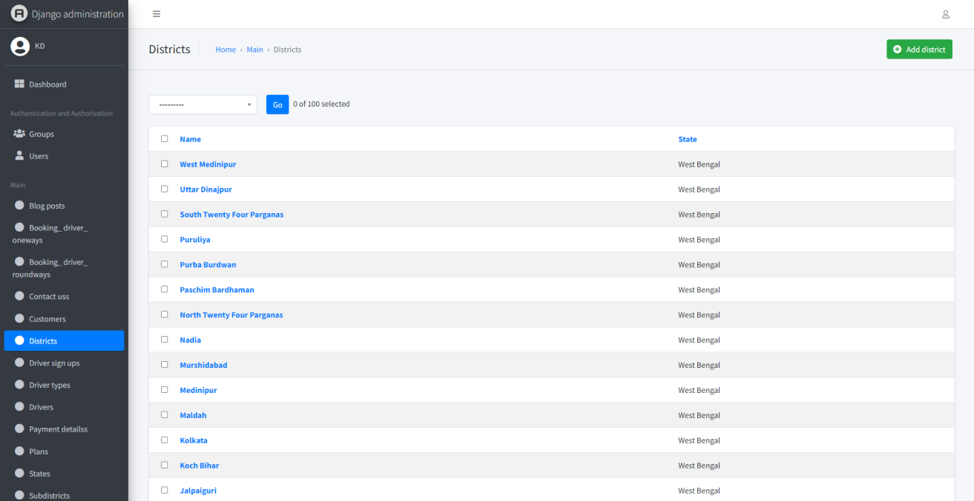
District
7)

Slide 72
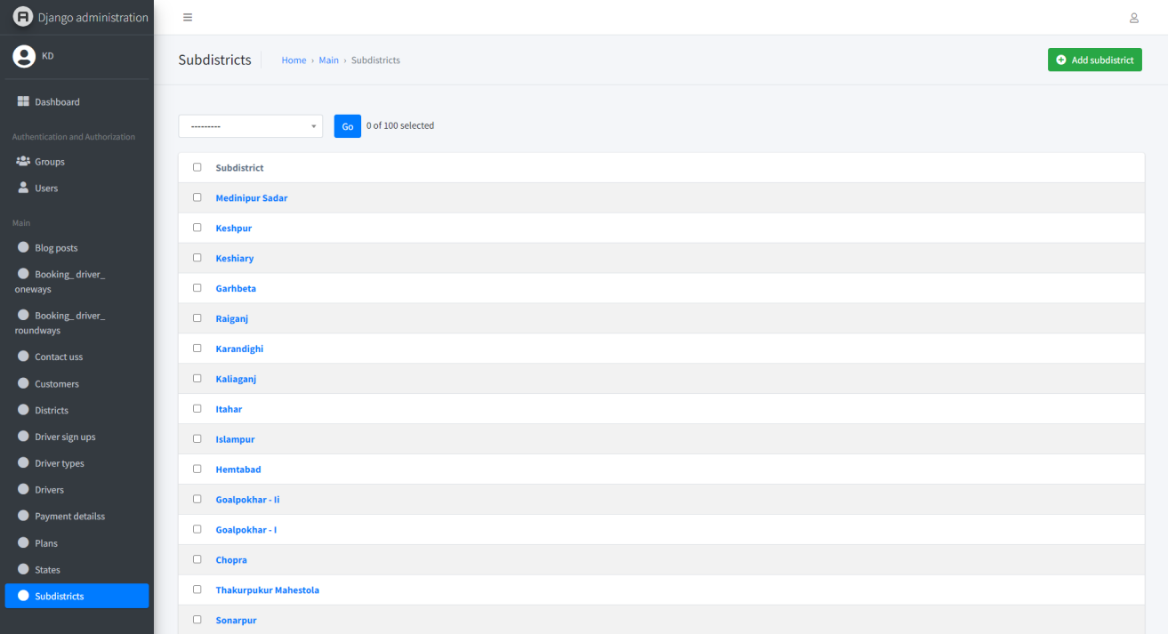
SubDistrict
8)

Slide 73
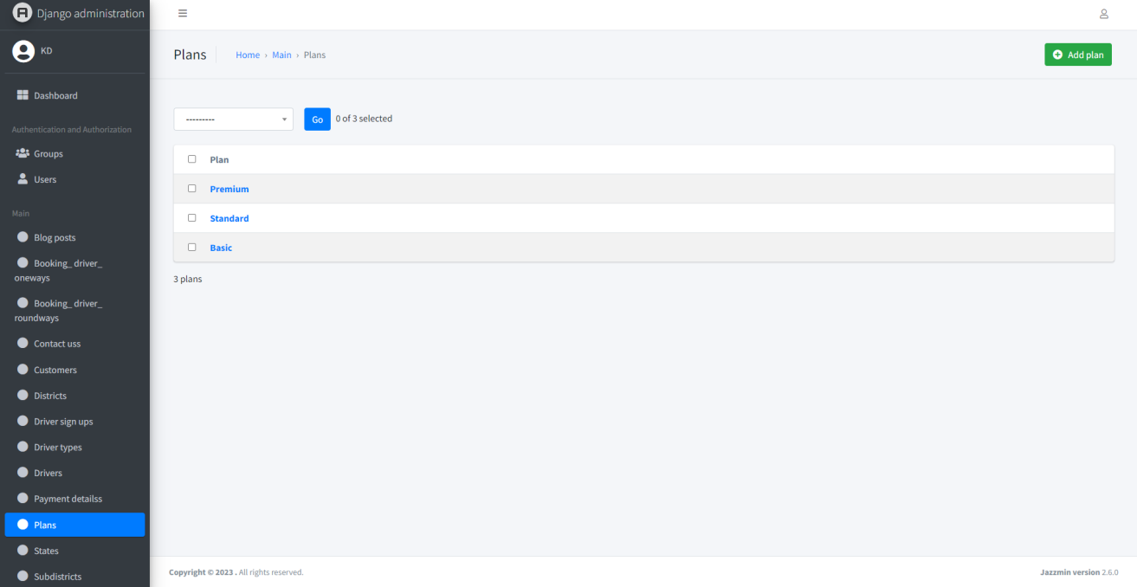
Plan
9)

Slide 74
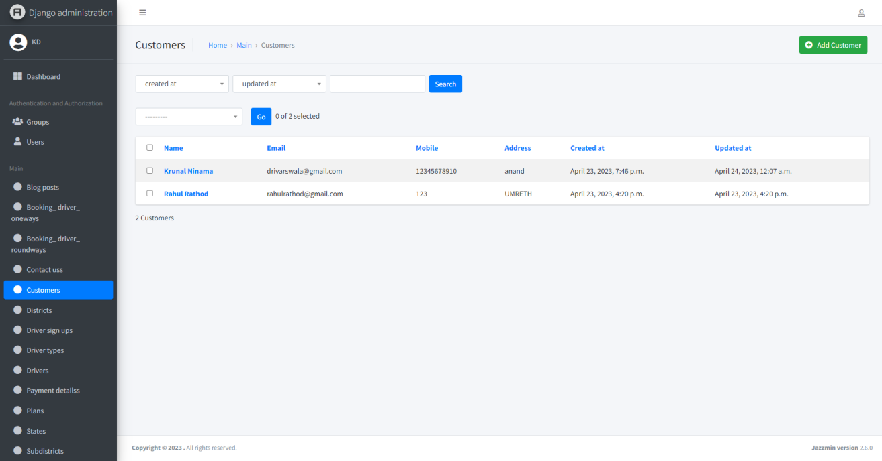
Customers
10)

Slide 75

Blog post
11)

Slide 76

Contect-US
12)

Slide 77

Payment Details
13)

Slide 78

Driver Booking Oneway
14)

Slide 79

Driver Booking Roundway
15)

